Slide 1
YEAR 9 PHYSICS · TEACHING DECK
Work Like
a Physicist
Collecting, processing and presenting data · a unit in eight lessons
The teaching lives in the speaker notes. Open the notes pane before you begin.
Notes:
WORK LIKE A PHYSICIST — Year 9 unit, 8 lessons.
HOW THIS DECK WORKS
• Every lesson opens with a divider slide showing the shape of the lesson — the stages in order, no clock.
• Nothing on the slides tells you or the class how long anything should take. Suggested timings are in these notes only, as a starting point to ignore freely.
• Slides are deliberately sparse. The teaching is in these notes; the board is for the class.
• Task slides map onto the numbered tasks in the student booklet ("Work Like a Physicist — Year 9 Student Workbook"). Students write in the booklet, not on paper.
• Answers to booklet tasks are in these notes only — nothing is revealed on the board unless you say so.
THE THROUGH-LINE
The unit is not about equations. It is about producing evidence other people will accept. Lessons 1-2 build the language, 3-5 build the technique on structured practicals, 6 is a solo run, 7-8 is their own investigation.
BEFORE LESSON 1
Print or issue the booklets. Students keep one booklet for all eight lessons.

Slide 2
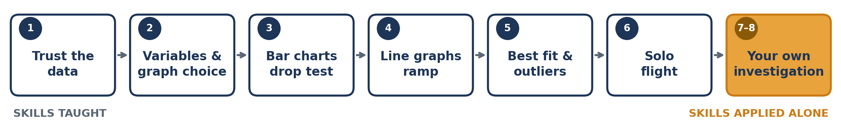
THE UNIT
Eight lessons, one skill
Take a measurement you can defend · show the pattern clearly · let the evidence decide.
LESSONS 1–2 · LANGUAGE
LESSONS 3–5 · TECHNIQUE
LESSONS 6–8 · INDEPENDENCE
Uncertainty, precision, accuracy, errors, variables and graph choice. No practical write-ups yet — just the vocabulary they will need for everything that follows.
Two structured practicals. Bar chart from categoric data, line graph from continuous data, then best-fit lines and outliers on their own results.
Paper helicopter solo challenge, then a self-designed investigation in pairs or threes. Light-touch assessment of the whole unit.
Overview
Notes:
THE ARC — worth saying out loud to the class in Lesson 1. Lessons 1-2 give them the words. Without "precision", "systematic", "categoric" they cannot describe what went wrong in an experiment, and they will fall back on "human error", which earns nothing. Lessons 3-5 are deliberately structured: the question, the method and the equipment are given, so all their attention goes on technique — repeats, means, tables, axes, scales, best-fit lines. Lesson 6 removes the scaffolding for one lesson. Lessons 7-8 remove it entirely. ASSESSMENT Lesson 6 and Lessons 7-8 both carry success-criteria checklists in the booklet, written in the same words you will mark against. Students self-assess first; that conversation is usually more useful than the mark. PRACTICAL EQUIPMENT TO BOOK L1: rulers, stopwatches, a ball or toy car. L3: balls, metre rulers, trays, 4-5 materials per group (sponge, cardboard, cloth, rubber mat, bubble wrap). L4: ramps, trolleys or toy cars, metre rulers, blocks. L6: paper, scissors, paperclips, stopwatches. L7-8: a mixed pool of the above.

Slide 3
LESSON
1
Can this data be trusted?
Uncertainty · precision · accuracy · resolution · random and systematic error
THE SHAPE OF THE LESSON
1
2
3
4
5
6
7
8
The case
Which data would you trust?
Precision vs accuracy
Uncertainty
The two errors
Resolution
Mini practical
Checkpoint
Lesson 1
Notes:
LESSON 1 — the foundation lesson. Everything else in the unit leans on it. WHAT THEY MUST LEAVE WITH 1. Every measurement carries doubt, and you can put a number on it. 2. Precise ≠ accurate. 3. Repeats fix random error and do nothing for systematic error. THE ONE MISCONCEPTION TO HUNT Students believe precise means correct. The whole lesson is built to break that. If they leave saying "our results were really precise so they must be right", the lesson has not landed. KEEP IT CONCRETE. This is not an uncertainty-analysis lesson. Half the range is enough for Year 9. TIMING RISK: the mini practical will eat the checkpoint if you let it. Give a hard 5-minute warning at 40 minutes.

Slide 4
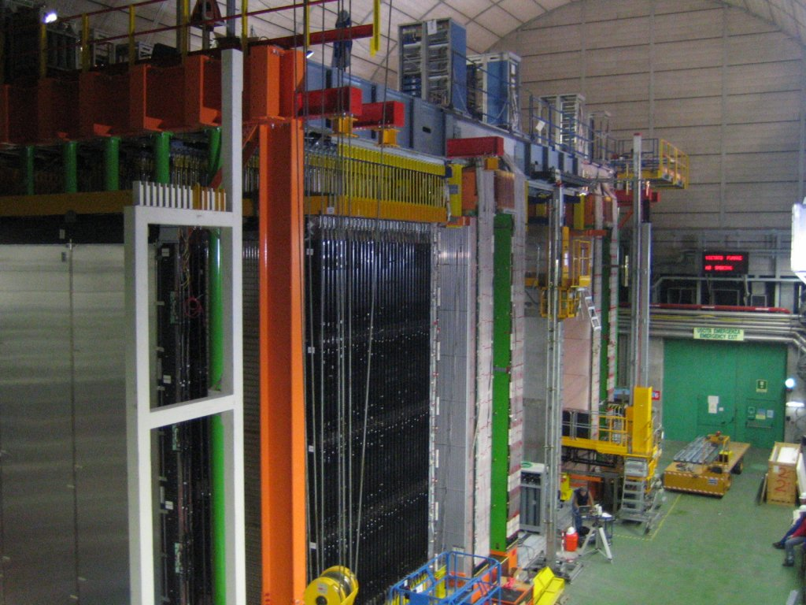
THE CASE
The loose cable that broke physics
September 2011. A team in Italy times neutrinos over 730 km and finds them arriving about 60 nanoseconds earlier than light.
They had repeated it thousands of times. The results were beautifully consistent. Newspapers said Einstein was wrong.
Months later they traced it to their own equipment — including a fibre-optic cable that was not properly connected. Every reading had been shifted the same way. Repeating could never reveal it.
Photo: MhieR / Wikimedia Commons (CC BY-SA 3.0)
Consistent does not mean correct. Today you learn the difference.
Lesson 1 · The case
Notes:
DELIVER THIS IN TWO MINUTES. Do not turn it into a physics lecture on neutrinos — they do not need to know what a neutrino is. The story is a vehicle for one idea. TELL IT LIKE THIS "Some of the best-equipped physicists in the world announced they had broken the speed of light. They had checked it thousands of times and got the same answer every time. They were wrong — a cable wasn't screwed in properly, and it shifted every single reading by the same tiny amount." THE QUESTION TO LAND ON "Why didn't repeating the measurement thousands of times save them?" Take answers. You want: because the fault affected every reading in the same direction. Do not name it "systematic" yet — that word arrives at 24 minutes. Let them feel the problem before they get the label. DELIBERATELY NO DIAGRAM HERE. Let them picture it. The two error types get their own diagram at 24 minutes, and it lands harder once they have already met the problem.
[Sources] Case photo: OPERA detector during construction, November 2005. MhieR, CC BY-SA 3.0 / GFDL. https://commons.wikimedia.org/wiki/File:OPERA-Experiment-Nov2005.jpg Case background: https://en.wikipedia.org/wiki/OPERA_experiment [/Sources]

Slide 5
1
STARTER · BOOKLET L1 TASK 1
Which data would you trust?
Three students timed the same car on the same ramp. Sets A and B have exactly the same mean.
Set | Trial 1 / s | Trial 2 / s | Trial 3 / s | Mean / s
A | 1.20 | 1.22 | 1.21 | 1.21
B | 1.05 | 1.47 | 1.12 | 1.21
C | 0.91 | 0.92 | 0.91 | 0.91
Which would you rely on?
How can C be tidy and still wrong?
Why take three readings?
Lesson 1 · Task 1
Notes:
5 MINUTES. Books open, pens down for the first minute — make them look before they write. ANSWERS (a) Set A. Same mean as B, but the readings agree with each other, so one more trial is unlikely to move the mean much. In B a single extra reading could shift it a long way. (b) Set C is the tightest set of the three, but it sits 0.30 s away from the other two. If the true value is near 1.21 s, C is precise and inaccurate — most likely something systematic, e.g. they started the timer at the wrong moment every time. (c) A single reading gives you no way to know whether it is typical. Repeats show you the spread, and the spread is what tells you how much to trust the mean. WATCH FOR Students saying B is "wrong". It isn't wrong — it is imprecise. Push them to that word if it has already come up, or hold it for the next slide. DO NOT yet say the words precision or accuracy if you can avoid it. Let them describe the sets in their own words first; the vocabulary lands harder in two minutes' time when they already need it.

Slide 6
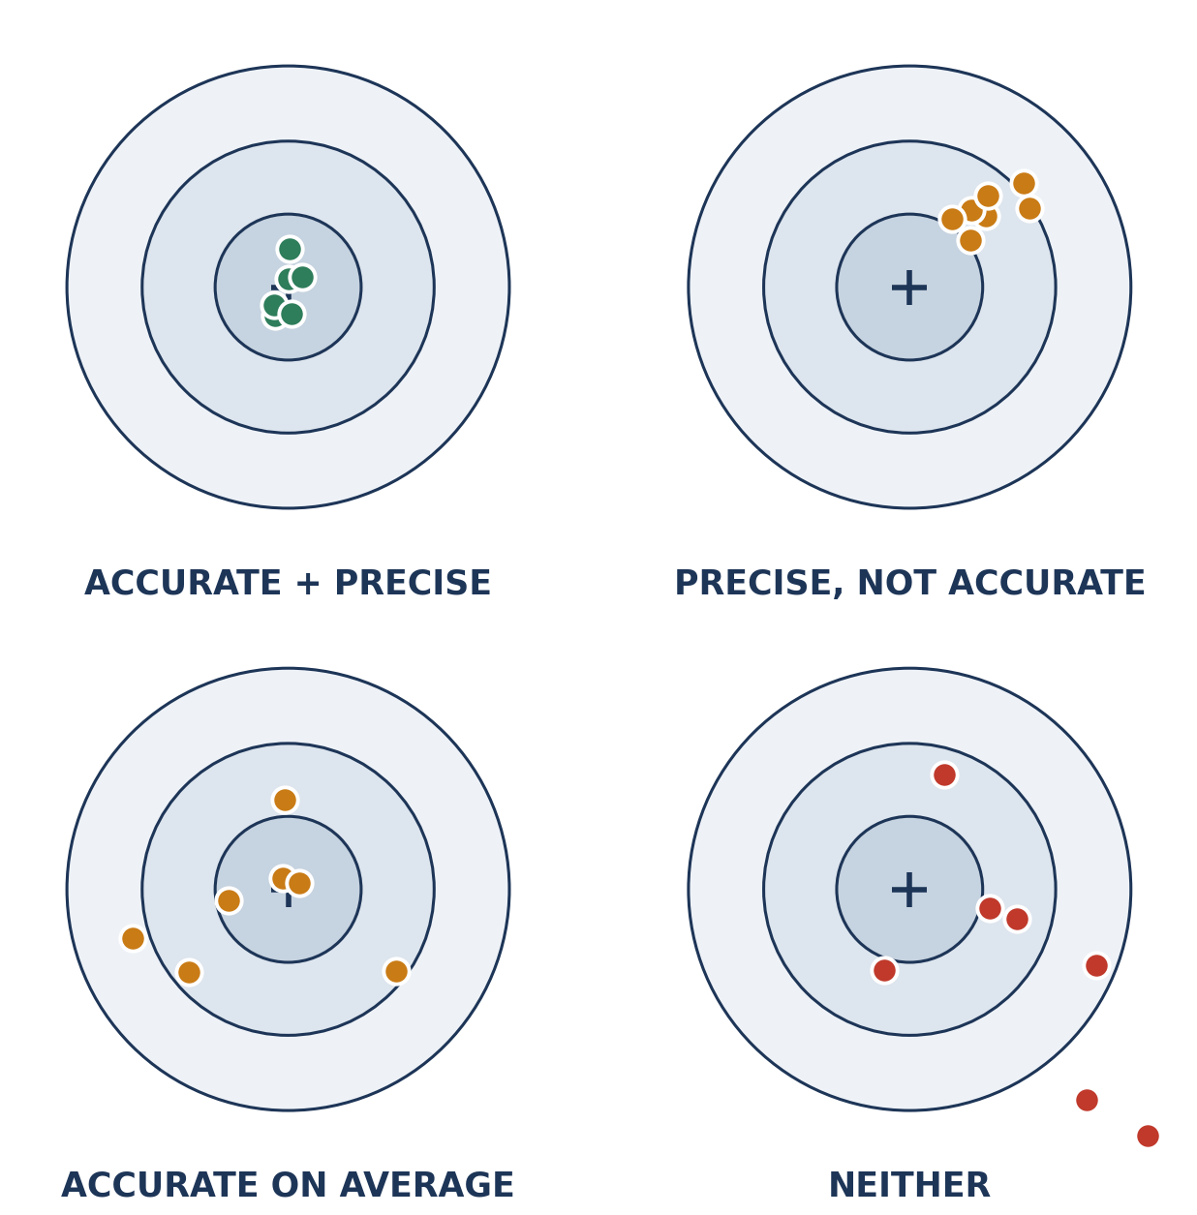
KEY IDEA
Precise and accurate are different words
Precision = how close your repeats are to each other. Accuracy = how close you are to the truth.
Lesson 1 · Key idea
Notes:
8 MINUTES — this is the heart of the lesson. RUN IT AS A COLD-CALL SEQUENCE, not a lecture. Point at each target and ask "precise? accurate? both? neither?" before you reveal the label underneath. THE SENTENCES THEY SHOULD OWN "Precise measurements are close to each other." "Accurate measurements are close to the true value." Then the killer question: "Can you be precise and wrong?" — top-right target. Yes. That was the neutrino team. And: "Can you be right on average but sloppy?" — bottom-left. Yes, and this is common in class practicals. BOOKLET L1 TASK 2 (~4 min): students invent a school-lab example for each of the four rows. Good examples to offer if they stall: • Accurate + precise — three people measure the same book with the same mm ruler, all agree. • Precise, not accurate — everyone measures from the end of the ruler instead of the zero mark; all agree, all 4 mm too long. • Accurate on average — timing a swinging pendulum by hand; scattered, but the mean is close. • Neither — measuring a bouncing ball's height by eye from across the room. Task 2(a): the neutrino result is PRECISE BUT NOT ACCURATE. Get them to say why in a full sentence.

Slide 7
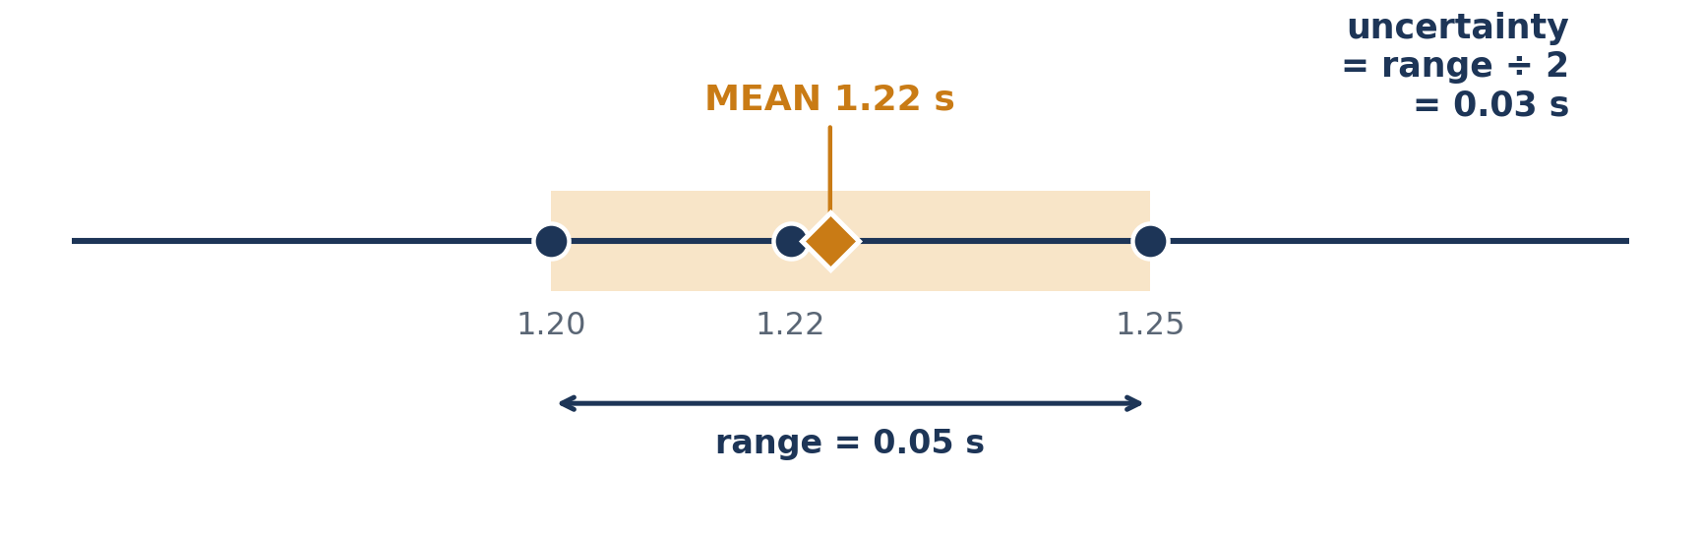
KEY IDEA · BOOKLET L1 TASKS 3–4
Put a number on the doubt
uncertainty = ( largest − smallest ) ÷ 2 written as: 1.22 s ± 0.03 s
Lesson 1 · Uncertainty
Notes:
8 MINUTES. Work the example on the board with them, then set them going. THE FOUR STEPS — do all four out loud, slowly. Readings 1.20, 1.25, 1.22. 1. Mean = 3.67 ÷ 3 = 1.22 s 2. Range = 1.25 − 1.20 = 0.05 s 3. Uncertainty = 0.05 ÷ 2 = 0.025 s → round to 0.03 s 4. Write it: 1.22 s ± 0.03 s Read the final line out loud as English: "somewhere around 1.22 seconds, give or take 0.03." That translation is what makes ± mean something rather than being a symbol they copy. BOOKLET L1 TASK 4 ANSWERS (~5 min) A: 12.0, 12.2, 12.1 → mean 12.1, range 0.2, uncertainty 0.1 B: 8.4, 9.1, 8.7 → mean 8.73 (8.7), range 0.7, uncertainty 0.35 (0.4) C: 25.0, 25.0, 25.1 → mean 25.03 (25.0), range 0.1, uncertainty 0.05 D: 3.20, 3.65, 3.25 → mean 3.37, range 0.45, uncertainty 0.225 (0.23) (b) Most precise: C. Largest uncertainty: B... check they compare 0.35 with D's 0.225 — B is larger. (c) D is the one to repeat: 3.65 sits well away from the other two and looks like a possible mistake rather than ordinary scatter. Accept B with good reasoning. ROUNDING: don't lose the lesson to significant figures. "One or two figures, sensibly" is enough here.

Slide 8
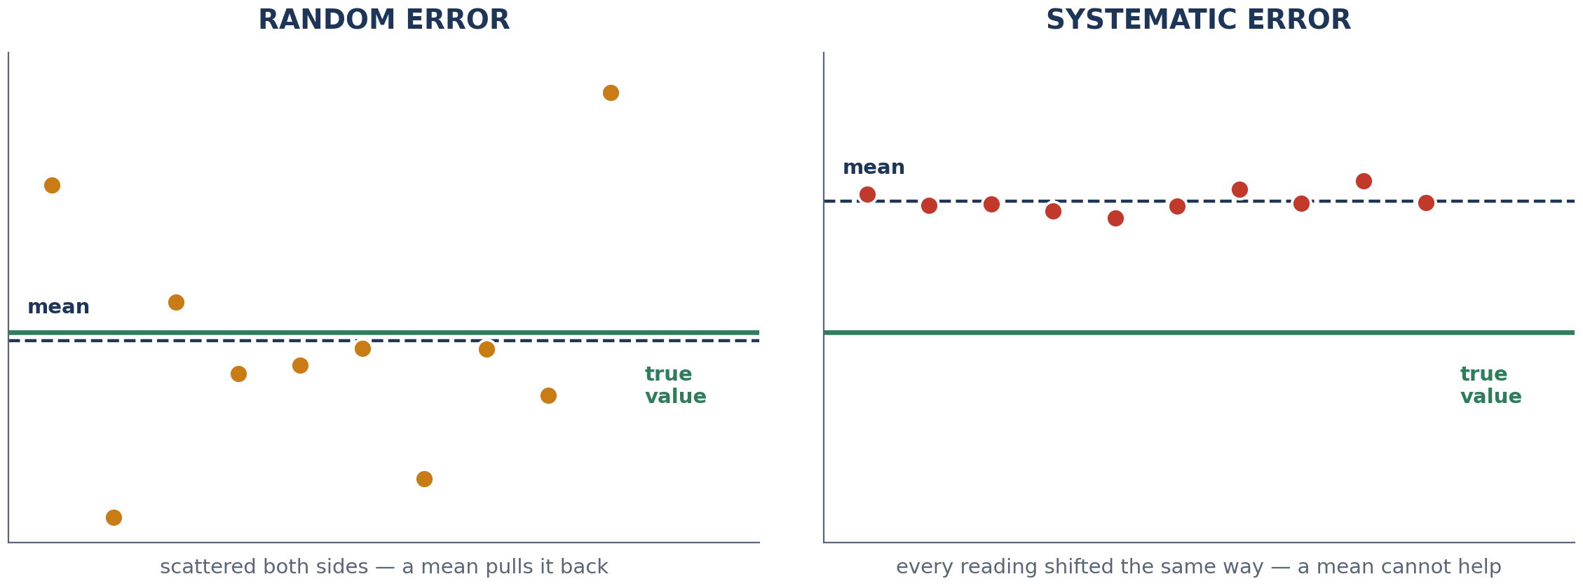
KEY IDEA · BOOKLET L1 TASK 5
Two errors. Only one is fixed by repeating.
RANDOM — scatters both ways — repeats help
SYSTEMATIC — shifts everything one way — repeats do nothing
Lesson 1 · The two errors
Notes:
8 MINUTES. This is the idea that comes back in every remaining lesson, so spend the time. DEFINITIONS IN THEIR WORDS Random — varies unpredictably between repeats. Reaction time on a stopwatch is the classic. Systematic — shifts every reading the same way. A ruler read from its end, a balance never zeroed, a cable not screwed in. THE CRITICAL QUESTION (Task 5a): "Why can't more repeats rescue you from a systematic error?" Answer you want: because averaging cancels out scatter that goes both ways. A systematic fault pushes every reading in the SAME direction, so the mean is shifted by exactly the same amount as every individual reading. More data just gives you a more confident wrong answer. TASK 5 SORTING — ANSWERS • Stopwatch started slightly late each time — SYSTEMATIC (note "each time"; if it were sometimes early, sometimes late, it would be random). This is the deliberately arguable one — accept random with a good argument, then show them the wording. • Ruler starts measuring from its very end — SYSTEMATIC • Judging bounce height by eye — RANDOM • Balance reads 0.2 g with nothing on it — SYSTEMATIC • A draught from an open window — RANDOM • Reading a scale at an angle, always the same side — SYSTEMATIC BANK THIS PHRASE for later lessons: "human error" is not an answer. Name the mechanism.

Slide 9
6
QUICK · BOOKLET L1 TASK 6
Resolution: what the instrument can even see
The smallest change an instrument can detect. If it cannot see the change, the information is not in your data.
RULER · 1 cm marks
RULER · 1 mm marks
STOPWATCH · 0.01 s
BALANCE · 0.1 g
Resolution 1 cm. Cannot see a 0.5 mm change.
Resolution 1 mm. Still cannot resolve 0.5 mm.
Resolution 0.01 s — far finer than your reaction time.
Resolution 0.1 g. Extra decimals ≠ extra truth.
Better resolution gives you more decimal places — it does not make you right
Lesson 1 · Resolution
Notes:
4 MINUTES — keep this brisk, it is the smallest idea in the lesson. DEFINITION: the smallest change the instrument can detect. THE POINT WORTH MAKING: a stopwatch reading to 0.01 s looks impressively precise, but human reaction time is around 0.2 s. The instrument's resolution is 20 times finer than the person using it. So the limit on their timing is not the stopwatch — it is them. That is why they repeat. QUICK CHECKS "What is the resolution of a ruler marked every mm?" — 1 mm. "Would a better balance have saved the neutrino team?" — No. Their problem was systematic, not resolution. Task 6 table answers: 1 cm / no; 1 mm / no (0.5 mm is below its resolution); 0.01 s; 0.1 g.

Slide 10
7
PRACTICAL · BOOKLET L1 TASK 7
Measure something three times
Three trials. Record as you go. Then: mean, uncertainty, and one error of each type — named specifically.
CHOOSE ONE
RECORD
THEN ANSWER
Dropped-ruler reaction test
Toy car down a small ramp
Bounce height of a ball
One object, two different rulers
Three trials, written down as you take them
Mean
Uncertainty = range ÷ 2
The instrument and its resolution
One random error — and how you know it was random
One systematic error — and how you would hunt for it
Lesson 1 · Mini practical
Notes:
9 MINUTES INCLUDING HANDOUT AND TIDY-UP. It is tight. Pick ONE task for the whole class rather than letting groups choose — it halves the setup time and makes the plenary comparable. RECOMMENDED: the dropped-ruler reaction test. Cheapest, fastest, and it produces obvious random error, which is exactly what you want them to see. WHILE THEY WORK, circulate and ask one question per group: "What is the resolution of the thing you're measuring with?" "Is your spread random or systematic — how do you know?" THE ANSWER YOU ARE FISHING FOR on random vs systematic: if the readings scatter above and below, it is random. If they all drift the same way — e.g. every drop caught later than the last because they got nervous — that is systematic. COMMON SYSTEMATIC ERRORS IN THESE TASKS Ruler drop: catching hand not starting level with the zero mark. Ramp: measuring from the wrong end of the ramp. Bounce: eye above or below the bounce height every time. HARD STOP AT 45. Books can be finished for homework — the checkpoint matters more than a completed table.

Slide 11
CHECKPOINT
Checkpoint — Lesson 1
1
A set of results that are close together is ____________.
2
A result close to the true value is ____________.
3
Uncertainty is calculated using ____________.
4
Repeats fix ________ errors but not ________ errors — why?
5
Name one thing you would change to make your data more reliable.
Lesson 1 · Checkpoint
Notes:
5 MINUTES. Booklet checkpoint, then take answers to 4 out loud — it is the one that separates understanding from memorising. ANSWERS 1. precise 2. accurate 3. (largest − smallest) ÷ 2 — half the range 4. Repeats fix RANDOM errors but not SYSTEMATIC errors, because averaging cancels scatter that goes both ways, while a systematic fault shifts every reading — and therefore the mean — by the same amount in the same direction. 5. Anything specific: more repeats, check the instrument reads zero, one person does all the timing, measure from the marked zero. EXIT LISTENING: if you hear "our results were precise so they were accurate", stop and re-run the top-right target from the precision/accuracy slide before they leave. HOMEWORK (booklet, Take it home): find a claim with a number in it and write one question you would ask before believing it. Collect two or three at the start of Lesson 2 — they make a strong link into the variables lesson.

Slide 12
LESSON
2
What are you actually changing?
Variables · continuous and categoric data · choosing the right graph
THE SHAPE OF THE LESSON
1
2
3
4
5
6
7
The case
Take the question apart
Two kinds of data
Sort the investigations
Surface demo
Fix the broken plan
Checkpoint
Lesson 2
Notes:
LESSON 2 — the decision lesson. Everything students draw for the rest of the unit is decided here. WHAT THEY MUST LEAVE WITH 1. Independent = what I change. Dependent = what I measure. Control = what I hold still. 2. Continuous vs categoric. 3. Graph choice follows the INDEPENDENT variable. Nothing else. THE ONE MISCONCEPTION TO HUNT "My results are numbers, so it's a line graph." This is the single most common error in the unit and it will cost them marks in every remaining lesson. Attack it explicitly on the "two kinds of data" slide. NO WRITE-UP THIS LESSON. It is a thinking lesson. Keep the pace fast and the examples coming.

Slide 13

THE CASE
The study that proved nothing
An energy drink company runs a trial. Students who drank it scored higher on a maths test than students who did not. The advert writes itself.
But the drinkers sat the test in the morning and the non-drinkers sat it after lunch. Different students. Different rooms. One group knew they were being watched.
The drink changed — and so did everything else. When more than one thing changes at once, no result can tell you which change caused what.
Change one thing. Measure one thing. Nail everything else down.
Lesson 2 · The case
Notes:
2-3 MINUTES. Deliberately an everyday example rather than a physics one — the logic is what transfers. TELL IT, THEN ASK: "So is the study weak evidence, or no evidence?" Push them to NO evidence. If four things changed at once, the result is genuinely uninformative — you cannot even say the drink probably helped a bit. That distinction is worth 30 seconds of argument. FOLLOW-UP: "What would you have to fix to make this a fair test?" Same students or matched groups, same time of day, same room, nobody told which drink they had. LINK BACK: if you collected homework claims from Lesson 1, read one out now and ask the same question of it. Then straight into Task 1 — do not let the discussion run past 3 minutes.
[Sources] Visual: AI-generated fictional classroom scenario; no named people, school, company, or brand is depicted. Prompt summary: British secondary-school maths test, pupils with plain unbranded drink cans, adult researcher, documentary photography. [/Sources]

Slide 14
1
BOOKLET L2 TASK 1
Take the question apart
For each question: what I change, what I measure, what I hold still. Two control variables minimum.
1
2
3
4
How does ramp height affect trolley speed?
Which material is the best thermal insulator?
How does the number of elastic bands affect launch distance?
Which drink contains the most sugar?
Then: if you failed to control the variables you listed, what exactly goes wrong with your conclusion?
Lesson 2 · Task 1
Notes:
8 MINUTES. Do question 1 together on the board, then let them do 2-4 in pairs. Circulate. ANSWERS 1. Change ramp height · measure speed of trolley · control: same trolley, same ramp surface, same release point, no push. 2. Change material · measure temperature drop (or time to cool by a set amount) · control: same starting temperature, same volume of water, same container, same thickness of material, same room. 3. Change number of elastic bands · measure launch distance · control: same launcher, same projectile, same stretch distance, same angle. 4. Change drink brand · measure mass of sugar (or use the label) · control: same volume of drink, same method of measuring. THE COLUMN THEY RUSH is control variables. Insist on two real ones. "Keep it fair" is not a control variable. "Same volume of water" is. TASK 1(a) — the point of the question: an uncontrolled variable gives you an alternative explanation. If the trolley was pushed harder at the higher ramp, you cannot tell whether the extra distance came from the height or the push. Get one student to say that sentence about their chosen question. NOTE FOR LATER: 2 and 4 are categoric, 1 and 3 are continuous. Do not point that out yet — it is the next slide, and it is more powerful if they meet it cold.

Slide 15
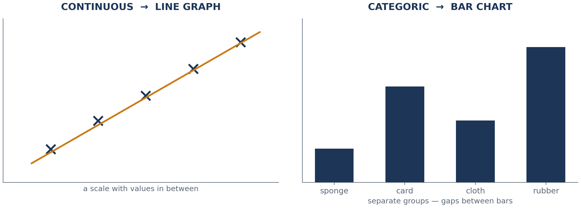
KEY IDEA
Two kinds of data — and only one decides your graph
Continuous → LINE GRAPH Categoric → BAR CHART
Lesson 2 · Key idea
Notes:
9 MINUTES. The most important nine minutes of the lesson. DEFINITIONS Continuous — a scale where the values in between exist and mean something. Length, time, mass, temperature. Between 5 and 10 there is a 7.3. Categoric — names or groups. Material, colour, brand, surface. There is nothing halfway between "sponge" and "cardboard", which is exactly why bar charts have gaps between the bars. THE GAPS POINT is worth making explicitly: the gap between bars is not decoration. It says "these categories are not points on a scale". NOW ATTACK THE MISCONCEPTION HEAD-ON. Put this on the board: "Which surface gives the most friction?" Ask: "What do we measure?" — distance in cm, a number. Ask: "So it's a line graph?" — let them say yes. Then: "What did we CHANGE?" — the surface. Sponge, carpet, sandpaper. Those are categories. So: BAR CHART. The dependent variable is almost always a number. It never decides the graph. SAY THE RULE, MAKE THEM SAY IT BACK: "It depends on what you changed, not what you measured." CHECK QUESTIONS (whiteboards, 30 seconds each) "Temperature — continuous or categoric?" continuous "Material type?" categoric "Number of elastic bands?" continuous (accept discrete/continuous discussion at this level — it goes on a scale, so line graph) "Colour of the car?" categoric

Slide 16
3
BOOKLET L2 TASK 3
Sort the investigations
LINE or BAR — and name the independent variable, labelled continuous or categoric. Both parts, or no marks.
LINE or BAR ?
LINE or BAR ?
Temperature → dissolving time
Which surface gives most friction?
Mass → stretch of a spring
Which paper towel absorbs most water?
Pendulum length → time period
Which material is the best sound absorber?
The answer is never just the graph — it is the graph plus the reason
Lesson 2 · Task 3
Notes:
8 MINUTES. Pairs, then whole-class review with cold calling. ANSWERS — graph, independent variable, type 1. Temperature → dissolving time — LINE — temperature — continuous 2. Which surface gives most friction? — BAR — surface type — categoric 3. Mass → stretch of a spring — LINE — mass — continuous 4. Which paper towel absorbs most? — BAR — paper towel brand — categoric 5. Pendulum length → time period — LINE — length — continuous 6. Best sound absorber? — BAR — material — categoric THE PATTERN THEY SHOULD SPOT: "Which…?" questions are nearly always categoric and give bar charts. "How does X affect Y?" questions are usually continuous and give line graphs. Point this out at the end — it is a genuinely useful heuristic and it sets up Lessons 7-8, where they must write their question as "How does X affect Y?" INSIST ON THE FULL SENTENCE when you take answers: "Bar chart, because surface type is categoric." Not "bar chart". This is the sentence they will need to write in Lessons 3, 6, 7 and 8.

Slide 17
4
CLASS DEMO · BOOKLET L2 TASK 4
Which surface slows the car most?
Same car, same ramp, same release point — onto four different surfaces.
THE FOUR SURFACES
WHAT WE CHANGE
WHAT WE MEASURE
HARDEST TO CONTROL
bench
carpet
rubber mat
sandpaper
Surface type
Continuous or categoric?
Distance travelled / cm
So which graph — and why?
Three control variables.
Star the one you could not really hold still.
Lesson 2 · Demonstration
Notes:
10 MINUTES. A demonstration, not a class practical — you run it at the front, they analyse. SETUP: one ramp, one car, four surfaces laid out at the bottom. Release from the same marked point each time. Do two runs per surface so the variation is visible. WHAT THEY SHOULD CALL OUT Independent — surface type (categoric) Dependent — distance travelled in cm Graph — bar chart, because surface type is categoric DO NOT TALK OVER THE DEMO. Run it, then discuss. The cards on screen are the booklet's boxes, so they can fill them in as you go. TASK 4(a) — three control variables, star the hardest. Realistic answers: same car (easy), same ramp height (easy), same release point (easy), same starting push — i.e. none (harder), the surfaces being equally flat and equally worn (hardest, and genuinely not fully controllable). THE VALUABLE MOMENT: when they realise one control variable cannot really be controlled. Say so out loud — real experiments always have one. That honesty is what the evaluation in Lesson 8 is asking for. IF SHORT OF TIME: run the demo with two surfaces only and give the last 3 minutes to Task 5 instead.

Slide 18
5
STRETCH · BOOKLET L2 TASK 5
Fix the broken investigation
“I'll test whether expensive tennis balls bounce better. I'll drop an expensive ball from the window and a cheap one from my hand, and see which bounces higher.”
a · WHAT IS WRONG?
b · REWRITE IT
c · WHICH GRAPH?
Find two separate problems. Be precise about each one.
As a proper question in the form “How does X affect Y?”
And say why — using the word continuous or categoric.
Lesson 2 · Task 5
Notes:
7 MINUTES. Pairs. This pulls the whole lesson together and previews Lessons 7-8. WHAT IS WRONG — accept any two, well expressed • Two variables changed at once: the ball AND the drop height. The result cannot separate them. • Only one trial each — no repeats, no mean, no idea of the spread. • "Bounce better" is not measurable. Better how? Higher? Longer? • Only two balls tested — not enough to see a pattern. • Dropping from a window is unsafe and the height cannot be controlled or repeated. • "Expensive" is not a variable you can put on an axis — price is a proxy for something else. REWRITTEN — good versions "How does drop height affect the bounce height of a tennis ball?" (continuous → line graph) "How does ball type affect bounce height?" (categoric → bar chart) Both are correct. If you get both from the class, that is the ideal outcome — same equipment, different independent variable, different graph. Put them side by side on the board and let the class see that the graph is decided by the choice, not by the equipment. (c) Whichever they wrote, they must justify it with continuous or categoric.

Slide 19
CHECKPOINT
Checkpoint — Lesson 2
1
The independent variable is the thing I ____________.
2
The dependent variable is the thing I ____________.
3
Use a line graph when ____________.
4
Use a bar chart when ____________.
5
Explain to someone who missed today why the graph depends on the independent variable, not the dependent one.
Lesson 2 · Checkpoint
Notes:
5 MINUTES. Question 5 is the one that matters — everything else is recall. ANSWERS 1. change 2. measure 3. the independent variable is continuous 4. the independent variable is categoric 5. The dependent variable is nearly always a number, so it cannot tell the two graph types apart — it would point at "line graph" every time. The independent variable is the one that differs: if it is a scale, points in between mean something and a line is meaningful; if it is a set of names, there is nothing in between, so separate bars with gaps. COLD CALL 5 rather than collecting it. Listening to three students attempt the explanation is worth more than reading thirty written ones. BEFORE THEY GO: next lesson is a practical. Remind them the booklet comes with them. HOMEWORK (booklet): five investigation questions of their own — at least two bar, two line, each with the independent variable named and labelled.

Slide 20
LESSON
3
The drop test
Shock absorber practical · repeats and means · bar charts
THE SHAPE OF THE LESSON
1
2
3
4
5
6
7
The case
Variables first
Method + safety
Practical
Bar chart
Errors
Checkpoint
Lesson 3
Notes:
LESSON 3 — first practical. The aim is NOT good data. The aim is the experience of repeats, variation, means and a bar chart that follows from a categoric variable. WHAT THEY MUST LEAVE WITH 1. Three trials per material, then a mean. 2. A bar chart with equal bars, gaps, units on the y-axis. 3. One named random and one named systematic error from their own practical. EQUIPMENT PER GROUP: a ball (marble, bouncy ball or tennis ball — be consistent across the class), metre ruler, tray or box lid, and 4-5 materials: sponge, cardboard, cloth, rubber mat, bubble wrap. SET-UP TIP: clamp stands make the drop height repeatable and save arguments. If you have none, mark a drop height on the wall with tape. TIMING RISK: 20 minutes of practical is genuinely enough for 4 materials × 3 drops if the equipment is already on the benches when they walk in. Have it out before the lesson.

Slide 21
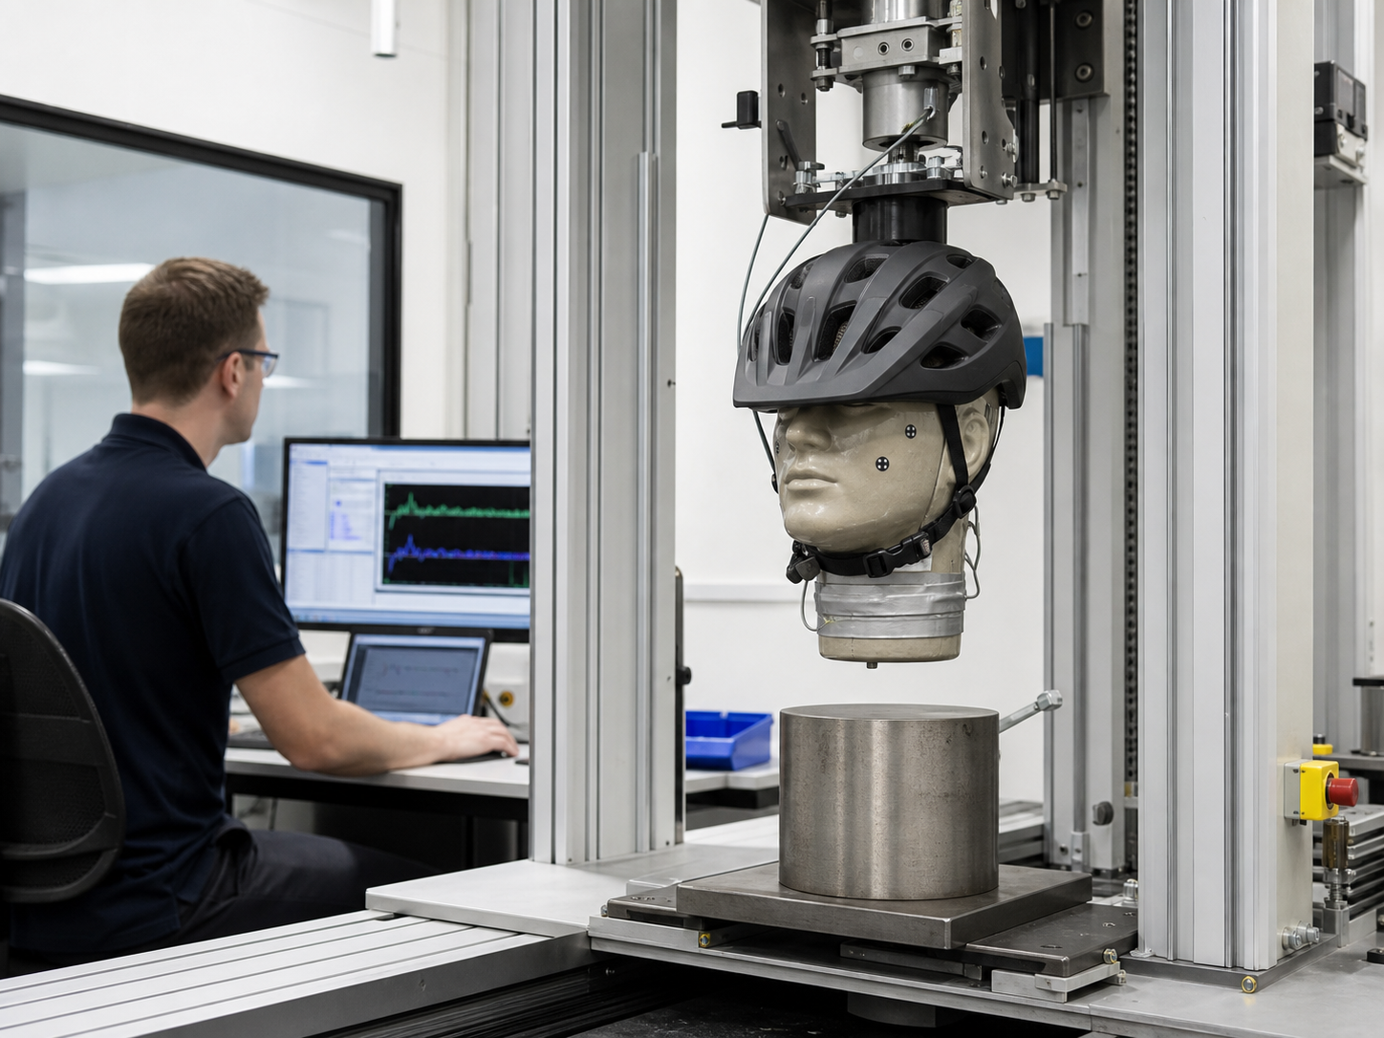
THE CASE
Why your helmet is made of polystyrene
A cycle helmet is mostly cheap foam. It is not there to be tough — it is there to be crushed.
By squashing over a few thousandths of a second, the foam stretches out the time your head takes to stop, and that lowers the force on your skull.
Nobody takes the manufacturer's word for it. Helmets are strapped to an instrumented head-shaped weight and dropped onto a steel anvil, over and over, before they can be sold. One lucky drop proves nothing.
Same drop. Same ball. Same height. Only the material changes.
Lesson 3 · The case
Notes:
2 MINUTES, then move — the practical needs the time. If you have a helmet to hand, bring it. Pressing a thumbnail into the foam makes the point in one second. THE PHYSICS IN ONE LINE: stopping over a longer time means a smaller force. They meet this properly in the forces unit; here it just motivates why "which material absorbs the hit best" is a real question. THE METHOD POINT: certification testing repeats the same drop many times on many helmets. Ask "why not just drop one helmet once?" — because one result tells you nothing about variation, and a helmet that passes once might fail the next time. THEN THE THINKING QUESTION, which sets up Task 1: "If a material is a good shock absorber, does the ball bounce HIGH or LOW off it?" Let them argue for 30 seconds. Answer: LOW — a good absorber keeps the energy instead of returning it to the ball. Students routinely get this backwards and then draw a correct chart with an inverted conclusion.
[Sources] Visual: AI-generated fictional product-safety laboratory; no named person, laboratory, manufacturer, or brand is depicted. Prompt summary: instrumented headform, bicycle helmet, vertical drop rig, steel anvil and monitoring engineer. [/Sources]

Slide 22
1
BOOKLET L3 TASK 1
Variables first — before anyone touches a ball
How does the type of material affect the bounce height of a ball?
INDEPENDENT
DEPENDENT
CONTROL
THEREFORE
Type of material
Categoric
Bounce height / cm
Continuous
Drop height
Same ball
Release method
Ruler position
Bar chart
Because the independent variable is categoric
Best shock absorber = LOWEST bounce. Decide this now, before you collect anything.
Lesson 3 · Task 1
Notes:
5 MINUTES. Fill the booklet table together — this is the one bit of the lesson where you want the whole class in step. THE CARDS ON SCREEN ARE THE ANSWERS. Reveal them by talking, not by reading them out — ask each one first. DO NOT SKIP the amber line. Every year several groups draw a perfect bar chart and then write "rubber mat was the best shock absorber" because it gave the biggest bounce. Make them write LOWEST BOUNCE = BEST in their booklet now. RELEASE METHOD is the control variable worth dwelling on: dropping is not throwing. A ball that is pushed even slightly leaves with extra speed and the whole trial is void. Demonstrate a clean release — fingers open, ball falls, hand does not follow it down. AGREE ONE DROP HEIGHT FOR THE WHOLE CLASS (50 cm works). It means groups can compare results at the end, which is a useful plenary you cannot have if everyone picks their own.

Slide 23
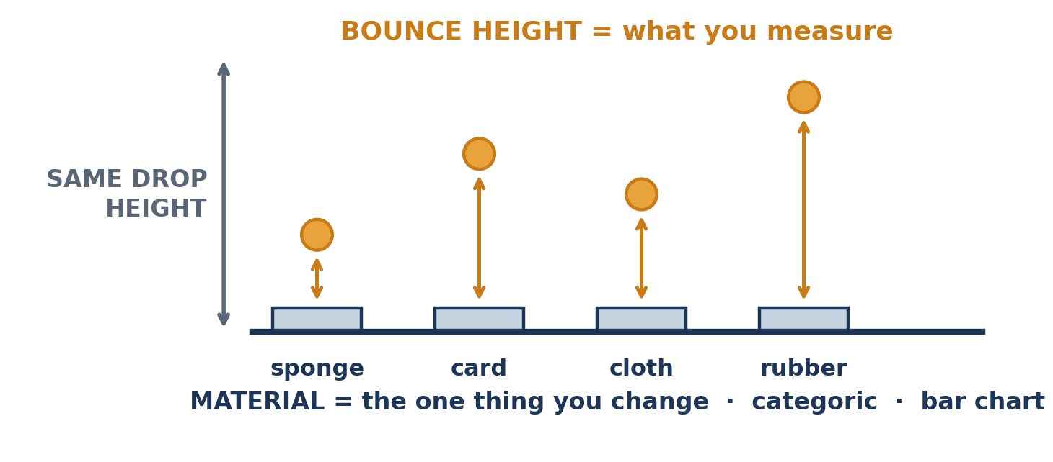
2
METHOD + SAFETY · BOOKLET L3 TASK 2
How to run it
Lesson 3 · Method
Notes:
5 MINUTES INCLUDING SAFETY. Demonstrate one full trial at the front — it saves ten minutes of wandering later. THE SIX STEPS (booklet) 1. Choose 4-5 materials and write them into the table. 2. Lay the material flat on the bench or in the tray. 3. Hold the ball at the agreed drop height every time. 4. Release — do not throw or push down. 5. Measure the height of the FIRST bounce, eye level with the top of it. 6. Three trials on that material, then move on. SAFETY — say all four • No throwing. Vertical drops only. • Stand back from the drop zone; do not crowd. • Check the tray and materials are stable before releasing. • Pick up any ball that escapes immediately — a marble on the floor is a slip hazard. JOB ROTATION: one drops, one measures, one records, then swap. Say it explicitly or one student will do everything and two will watch. THE HARD BIT is judging the bounce height by eye. Tell them now that this is the main source of random error and that it is exactly why they take three trials. It gives them a real answer for Task 5 later rather than "human error".

Slide 24
3
PRACTICAL · BOOKLET L3 TASK 3
Collect your results
4–5 materials · 3 trials each · write every number down as you take it · mean at the end
SET UP
COLLECT
BEFORE YOU STOP
Materials in the table, drop height agreed, one practice drop that you do not record.
Work through the materials. Three trials each. Record immediately — never from memory.
Calculate the means. Tidy the bench. Show one full mean calculation in your booklet.
Circulate: “what is your drop height?” · “show me trial 2” · “any reading you don't believe?”
Lesson 3 · Practical
Notes:
20 MINUTES. Put the three-phase timing on the board and call the transitions out loud — groups that lose track of time will do four trials on sponge and none on anything else. WHAT TO CHASE WHILE CIRCULATING • Tables with no units in the headings. Fix on the spot — it is a mark every single time in every exam. • Recording at the end from memory. Stop it immediately. • Groups changing drop height between materials without noticing. • Groups whose three trials are identical to the centimetre — usually means they are writing what they expect rather than what they see. Ask them to do a fourth in front of you. THE QUESTION THAT MAKES THEM THINK: "Which of your materials was hardest to measure, and why?" Usually the springy ones — the bounce is fast and high. That is a genuine random-error answer. MEAN CALCULATION: insist on one worked example written out in full, not just the answer in the box. Task 3(a). TASK 3(b) asks whether any single reading made them look twice, and what they did about it. This is the first appearance of outlier thinking — it returns properly in Lesson 5. Do not develop it now; just make sure something is written. AT 33 MINUTES: equipment down, everything away, whether or not the table is finished.

Slide 25
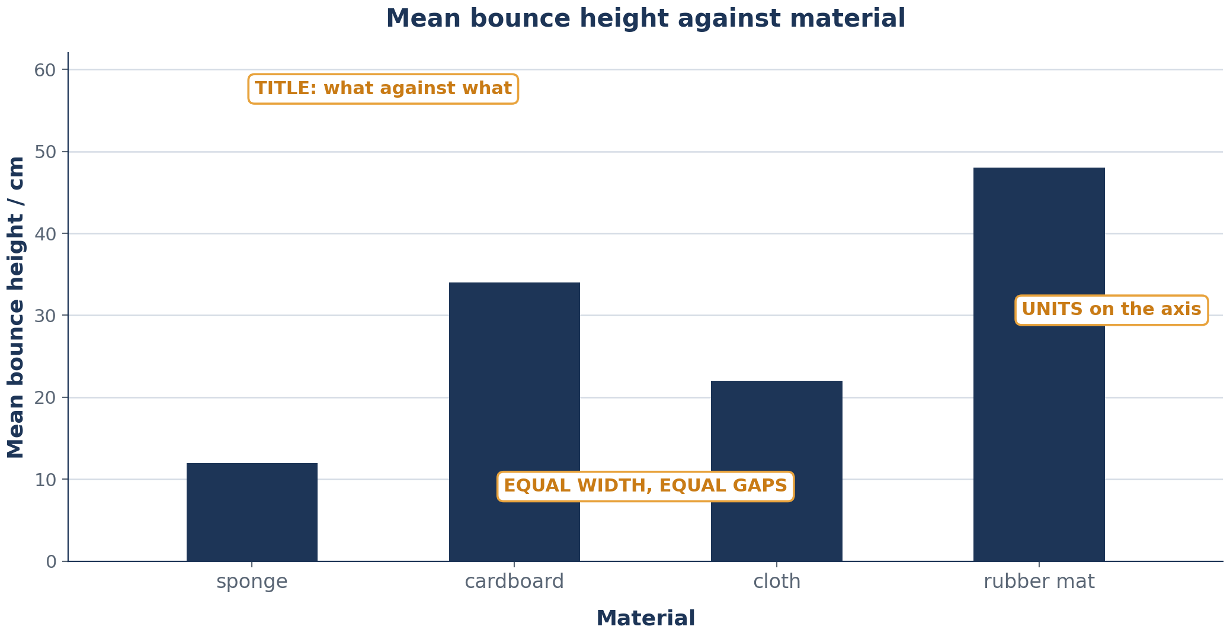
KEY IDEA · BOOKLET L3 TASK 4
Draw a bar chart that survives a strict marker
Title: what against what
Material on the x-axis
Units on the y-axis
Equal bars, equal gaps
Bars = the MEAN
Lesson 3 · Bar chart
Notes:
10 MINUTES. Five to set up, five to draw. They finish at home if needed. WORK THE SCALE OUT WITH THEM BEFORE ANYONE DRAWS. Ask for the biggest mean in the room, then: "how many big squares have you got? So what is each square worth?" Round up to something readable — 2, 5 or 10 cm per square. This 90-second exercise prevents the most common wrecked graph. THE FIVE THINGS ON SCREEN are the mark scheme. Say them as you point. WHY THE GAPS: because the categories are not points on a scale. Ask "could you have a material halfway between sponge and cardboard?" No. So the bars do not touch. This connects straight back to Lesson 2 — make the link explicit. BARS SHOW THE MEAN, not trial 1. Students who have not finished their means will quietly plot trial 1. Watch for it. MISCONCEPTION TO CATCH: some will want to join the tops of the bars with a line. Ask what a point between "cloth" and "rubber mat" would mean. Nothing. So no line. BOOKLET SELF-CHECK: Task 4 has a six-row checklist under the grid. Make them tick it before they show you.

Slide 26
5
BOOKLET L3 TASK 5
What the data says — and what went wrong
Name your best shock absorber with a number attached. Then name the errors — specifically. “Human error” is not an answer.
RANDOM · in this practical
SYSTEMATIC · in this practical
Judging the top of a fast bounce by eye
Eye level not exactly at the bounce height
Ball landing slightly off-centre on the material
Ruler not starting at the bench surface
Reading the ruler from above every time
Dropping from slightly the wrong height all lesson
Would ten more trials have fixed your systematic error? No — and they must be able to say why.
Lesson 3 · Errors
Notes:
5 MINUTES. The cards are prompts — take their versions first, then show these if they stall. TASK 5(a): the answer must quote a number. "Sponge, because it gave the lowest mean bounce at 9 cm compared with 41 cm for the rubber mat." Not "sponge was best". TASK 5(b): repeats let you spot variation and calculate a mean that is less affected by any single bad reading. TASK 5(c) IS THE KEY QUESTION and it is the Lesson 1 idea returning: no, more trials do not fix a systematic error, because every reading is shifted the same way, so the mean shifts by the same amount too. If a student can say that sentence unprompted, Lesson 1 has stuck. WORTH DOING IF YOU HAVE 60 SECONDS SPARE: compare two groups' results for the same material. They will differ — often a lot. Ask why. Different balls, different drop heights, different eyes. That is a preview of the reliability discussion in Lessons 7-8 and it costs nothing. TASK 6 (stretch, two questions on comparing groups and on foam thickness) is a good homework or extension for fast finishers. The thickness one is the useful one: changing to 1, 2, 3, 4 cm of foam makes the independent variable CONTINUOUS, so the graph becomes a line graph. That is the bridge into Lesson 4.

Slide 27
CHECKPOINT
Checkpoint — Lesson 3
1
I used a bar chart because the independent variable was ____________.
2
The best shock absorber was ________ because it gave the ________ bounce.
3
One possible random error was ____________.
4
One thing I would change if I ran this again.
Lesson 3 · Checkpoint
Notes:
2 MINUTES. Fast — books, pens, done. ANSWERS 1. categoric 2. their material, LOWEST bounce 3. anything specific to the drop test — judging the bounce by eye is the standard answer 4. anything concrete: clamp the ruler, film it and play back, more trials, one person measures throughout THE ONE TO SCAN FOR: number 2. Any student who has written "highest" has the physics backwards and will need catching before Lesson 6. NEXT LESSON: same structure, but the independent variable becomes continuous and the graph becomes a line graph. Tell them that now — it frames Lesson 4 as a deliberate contrast rather than a new topic. HOMEWORK (booklet): finish the bar chart if unfinished, plus Task 6 for anyone who wants the stretch.

Slide 28
LESSON
4
Higher ramp, further flight?
Ramp practical · continuous data · plotting a line graph properly
THE SHAPE OF THE LESSON
1
2
3
4
5
6
7
The case
Set it up
Method + safety
Practical
Choose the scale
Plot it
Checkpoint
Lesson 4
Notes:
LESSON 4 — the mirror image of Lesson 3. Same shape of lesson, continuous independent variable, line graph. WHAT THEY MUST LEAVE WITH 1. Five ramp heights, three trials each, means calculated. 2. A scale chosen deliberately before plotting. 3. Points plotted accurately as small crosses. NO BEST-FIT LINE THIS LESSON. That is Lesson 5, and drawing it early produces dot-to-dot lines that are hard to unlearn. Say explicitly: "points only today". EQUIPMENT PER GROUP: ramp, trolley or toy car, metre rule or tape, blocks or books to change the height, graph paper if not using the booklet grid. FLOOR SPACE is the constraint. Decide before the lesson whether groups work on benches or on the floor, and mark run lanes with tape if the room is tight. TIMING RISK: this practical over-runs more than any other in the unit. The 20 minutes is real only if the ramps are already set up.

Slide 29
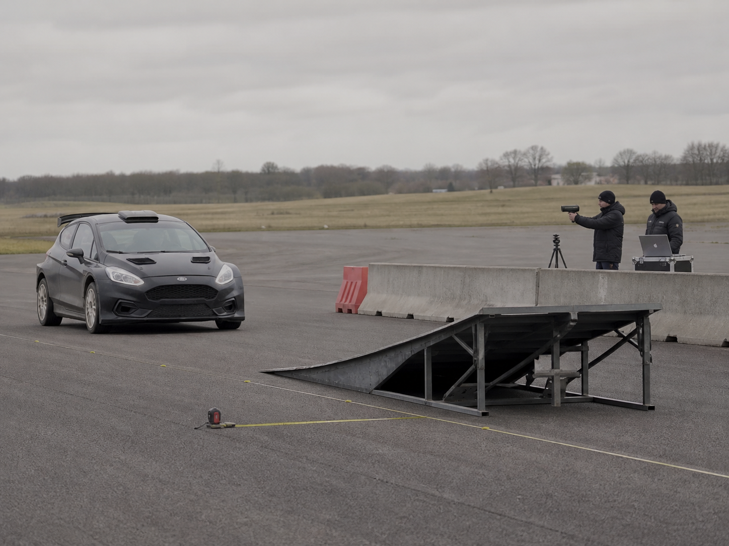
THE CASE
Nobody guesses a stunt jump
When a stunt team sends a car off a ramp, the driver does not find out how fast to go by trying it.
They build the ramp, run the car at several speeds, measure where it lands each time, and plot the results.
The graph is the point. With a line through five measured points you can read off the speed needed for a distance you have never actually tested.
One dot is an anecdote. Five points and a line make a prediction.
Lesson 4 · The case
Notes:
2 MINUTES. The purpose of this hook is to answer the question students never ask out loud: why bother with a graph at all? THE ANSWER: a line graph lets you predict values you did not measure. That is something a table cannot do and a bar chart cannot do. MAKE IT CONCRETE with the diagram on screen: "we measured at 5, 10, 15, 20 and 25 cm. What distance would 12 cm give?" Trace across from the line. You never did that experiment, but the graph answers it. TELL THEM THEY WILL DO EXACTLY THIS in Lesson 6 with the paper helicopter — reading a prediction off their own best-fit line. It gives today's plotting an obvious purpose. DO NOT let this run. The practical is the tight part of the lesson.
[Sources] Visual: AI-generated fictional stunt test; no named driver, team, vehicle maker, venue, or brand is depicted. Prompt summary: closed proving ground, unbranded car approaching a low ramp, safety barriers and engineers recording measurements. [/Sources]

Slide 30
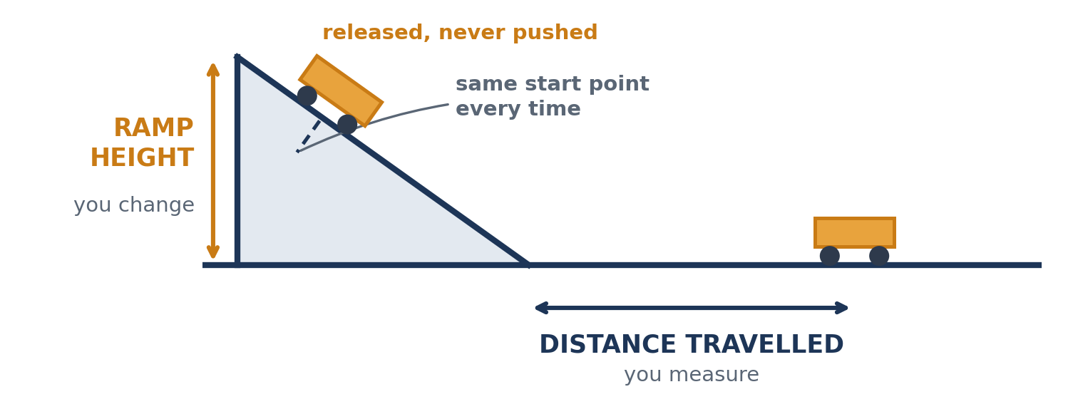
1
BOOKLET L4 TASK 1
Set it up
How does the height of a ramp affect the distance a trolley travels after it leaves the ramp?
FILL IN YOUR BOOKLET
Independent variable
Dependent variable
Continuous or categoric?
Which graph — and why?
Then four control variables. Tick each one off as your group agrees on it.
Lesson 4 · Set up
Notes:
5 MINUTES. ANSWERS FOR THE BOOKLET TABLE Independent — ramp height in cm — CONTINUOUS Dependent — distance travelled in cm Graph — line graph, because ramp height is continuous Control variables — same trolley, same ramp, same release point on the ramp, same floor surface, no push ASK IT AS A CONTRAST WITH LAST LESSON: "Last week we changed the material and drew a bar chart. This week we change the height. What is different?" You want: height is a number on a scale, so the values in between exist, so a line makes sense. THE FIVE HEIGHTS: 5, 10, 15, 20, 25 cm. Fix them for the whole class — comparable results make a much better plenary, and it stops groups picking three heights and running out of pattern. RELEASE POINT is the control variable that gets broken most. The trolley must start at the SAME point on the ramp every time, not at the top of whatever height the ramp happens to be. Mark it with tape. Demonstrate this — it is not obvious. SURFACE: if some groups run onto carpet and some onto lino, their numbers will not be comparable. Worth naming out loud even if you cannot fix it — it becomes a genuine evaluation point later.

Slide 31
2
METHOD + SAFETY · BOOKLET L4 TASK 2
How to run it
THE RUN
SAFETY
THE TIME-WASTER
1 Set the ramp to the height
2 Trolley on the marked start point
3 Release — never push
4 Measure from the bottom of the ramp to where it stops
5 Three trials, then change the height
Check the ramp is stable before every release
Never aim a trolley at a person
Bags and stools well clear of the run
Collect the trolley by hand — do not chase it
Having to redo a whole height because nobody wrote down trial 2.
Record every number the moment you read it.
5, 10, 15, 20, 25 cm · three trials at each · same start point every single run
Lesson 4 · Method
Notes:
4 MINUTES. Demonstrate one complete run at the front, including the measurement. Do not read the steps aloud — show them. DEMONSTRATE THE RELEASE deliberately: fingers open, no forward flick. Then do a bad one on purpose — a small push — and let them see how much further it goes. That single comparison does more than any instruction about fair testing. MEASURING FROM WHERE? Agree it as a class: from the bottom edge of the ramp to the front of the trolley where it stops. If half the class measures to the back of the trolley you get a systematic difference between groups, which is itself worth mentioning at the end. TROLLEYS THAT VEER SIDEWAYS: tell them now to measure the straight-line distance along the run, and to note it in the booklet if a run veered badly. Veering is the main source of random error here and it makes a strong evaluation point. SAFETY: say all four lines. Trolleys at ankle height in a busy lab are a real trip hazard. STRAIGHT INTO THE PRACTICAL AT 12 MINUTES.

Slide 32
3
PRACTICAL · BOOKLET L4 TASK 3
Collect your results
Five heights · three trials each · fifteen runs in total — so keep moving
SET UP
COLLECT
BEFORE YOU STOP
Ramp set at 5 cm, start point marked with tape, one practice run you do not record.
Work up through the heights. Three trials each. Write each number down as you read it.
Means for all five heights. One full mean calculation written out. Equipment away.
Circulate: “show me your start point” · “did that one veer?” · “what's your largest mean so far?”
Lesson 4 · Practical
Notes:
20 MINUTES. Announce the phase changes out loud at 5 and 25 minutes. THE LAST QUESTION ON THAT LIST — "what is your largest mean so far?" — is doing real work. It gets them thinking about the number they will need for the scale before they reach the graph, so the scale slide is quick. WHAT TO CHASE • Groups who moved the start point when they raised the ramp. The single most common invalidating mistake. • Trolleys released with a push. Watch hands, not trolleys. • Missing units in the table headings. • A group whose distances go DOWN as height goes up — usually the trolley is hitting something, or they are measuring to a different point. Worth investigating with them rather than fixing for them. MESSY DATA IS FINE AND USEFUL. Trolleys veer, floors vary, and the scatter this produces is exactly what makes Lesson 5's best-fit line necessary. If a group is upset that their points are not perfect, tell them that is the normal condition of experimental physics and it is why nobody joins the dots. TASK 3(a) and (b): they record their largest and smallest means and explain why you need both before choosing a scale. Make sure this is written — the next slide depends on it. HARD STOP AT 32. Equipment away.

Slide 33
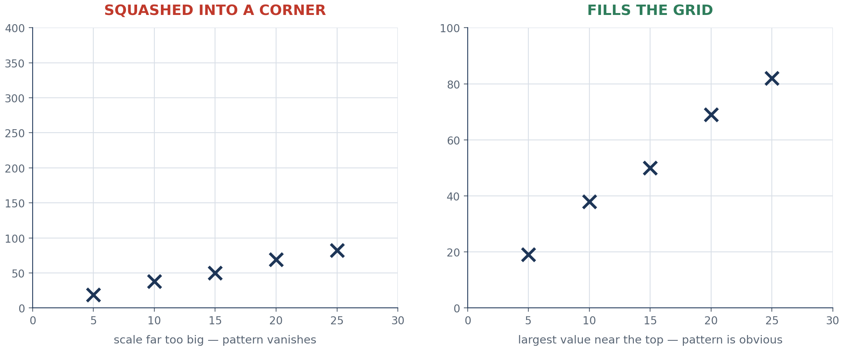
KEY IDEA · BOOKLET L4 TASK 4
Choose the scale before you plot anything
largest value ÷ big squares available → round UP to 1, 2, 5, 10, 20 or 50 per square
Lesson 4 · Scale
Notes:
6 MINUTES. More marks are lost to bad scales than to bad measuring, and this is the one skill students can fix completely in six minutes. WORK IT THROUGH WITH A REAL NUMBER FROM THE ROOM. Ask for someone's largest mean — say 84 cm. Count the big squares on the booklet grid. Divide. Round up to something readable. Then check 84 still fits. THE THREE BANNED MOVES, from the right-hand panel • Scales going up in 3s, 7s or 15s. Nobody can read a point between them. • Everything squashed into the bottom-left quarter of the grid. • Changing the step size halfway up an axis. THE TEST TO GIVE THEM: your largest point should sit near the top of the grid. If your highest point is a third of the way up, your scale is too big and the pattern is being hidden. BOOKLET TASK 4(a) and (b): they write their axis ranges and what each big square is worth, for both axes, BEFORE plotting. Do not let anyone start drawing until those two lines are filled in — checking thirty booklets for two written numbers takes ninety seconds and saves thirty ruined graphs.

Slide 34
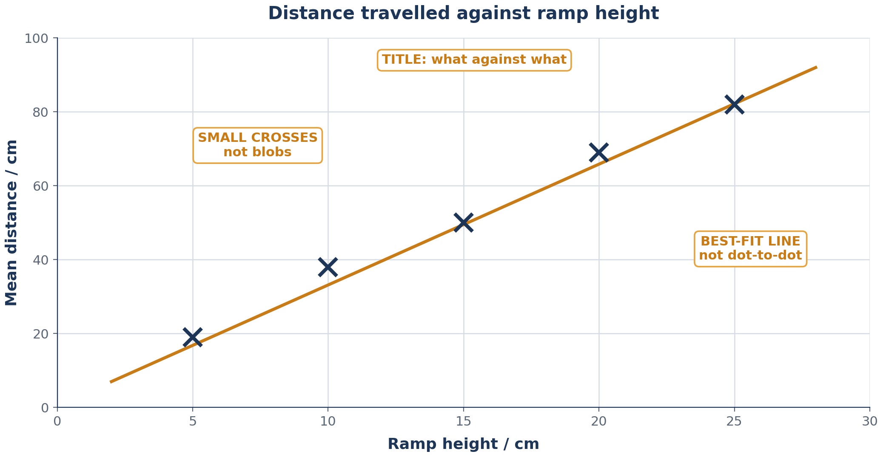
5
BOOKLET L4 TASK 5
Plot it — points only
Ramp height on the x-axis. Mean distance on the y-axis. Small crosses, not blobs. No line today.
Lesson 4 · Plot
Notes:
9 MINUTES of drawing. Circulate constantly; a wrong axis caught at minute 39 saves a redraw. SAY IT PLAINLY: NO LINE TODAY. Points only. If they join the dots now they will fight you about it next lesson. Tell them the line is Lesson 5's job and it needs its own explanation. WHY CROSSES NOT DOTS: a fat pencil blob is 2 mm wide and hides where the point actually is. A cross has an exact centre. Show the difference on the board — draw one of each and ask which one you could read a value from. THE FOUR THINGS TO CHECK AS YOU WALK AROUND 1. Independent variable (ramp height) on the x-axis — not the other way round. 2. Units on BOTH axes. 3. A title that says what against what. 4. Points actually where the numbers say, not evenly spaced by eye. TASK 6 — MISTAKE HUNT (if you reach it): students check their own graph and their partner's against six common faults. Swapping books is worth doing even if only for two minutes; students find faults in someone else's graph that they are blind to in their own. IF A GROUP FINISHES EARLY: ask them to predict, from their points alone, what distance a 12 cm ramp would give — and to say how confident they are without a line. It sets up Lesson 5 perfectly.

Slide 35
CHECKPOINT
Checkpoint — Lesson 4
1
The independent variable was ________, measured in ________.
2
The dependent variable was ________, measured in ________.
3
A line graph was right because ____________.
4
The hardest control variable to keep the same was ________ — why?
5
Straight line or curve? Commit to an answer and say why.
Lesson 4 · Checkpoint
Notes:
3 MINUTES. ANSWERS 1. ramp height, cm 2. distance travelled, cm 3. ramp height is continuous 4. Usually the release point, the trolley running straight, or the floor surface. Any of these with a real reason is right. 5. Genuinely open. Most class data looks roughly straight over this range. What matters is that they commit and justify from their own points — this is the question that makes Lesson 5 feel like it is answering something they already care about. DO NOT RESOLVE QUESTION 5. Take two opposing answers, leave it hanging, and open Lesson 5 with it. NEXT LESSON: bring this graph. They finish it, add the best-fit line, and find out whether their prediction was right. HOMEWORK (booklet): finish plotting if unfinished, and check the graph against the six-point checklist.

Slide 36
LESSON
5
The point that does not fit
Best-fit lines · outliers · graph quality · writing a conclusion
THE SHAPE OF THE LESSON
1
2
3
4
5
6
7
8
The case
Which graph is better?
Best-fit lines
Spot the outlier
Finish your graph
Peer review
Conclusion
Checkpoint
Lesson 5
Notes:
LESSON 5 — no practical, all analysis. Students need their Lesson 4 graphs; have spares of the ramp data on the board for anyone who was absent. WHAT THEY MUST LEAVE WITH 1. A best-fit line shows the trend; it does not have to touch any point. 2. An outlier is a question, not rubbish — check or repeat before discarding. 3. A conclusion quotes numbers. THE ONE MISCONCEPTION TO HUNT "Just ignore the weird result." Students want a rule. The rule is: find out why first. This is the closest the unit gets to teaching scientific honesty, and it is worth the time. SECOND MISCONCEPTION: that a best-fit line must pass through the origin, or through the first and last points. Neither is true. OPEN BY REOPENING Lesson 4's last question — straight line or curve? — and telling them today they will settle it from their own data.

Slide 37
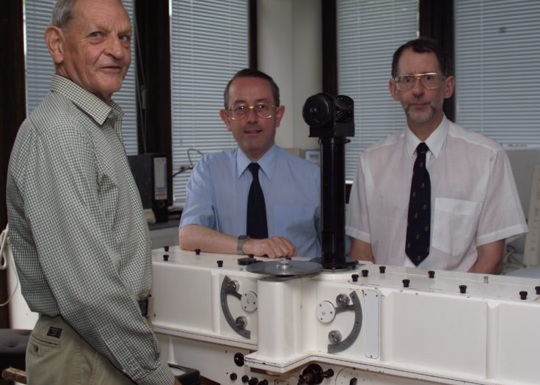
THE CASE
The readings that were too strange to believe
In 1985 three scientists from the British Antarctic Survey published something alarming: every spring, the ozone layer above Antarctica was collapsing.
Satellites had been watching the same sky. Their values were so far below anything expected that the processing software had been set to flag such extreme readings as probable instrument faults — so they were not treated as real.
Once the ground-based results were published, the satellite record was re-examined. The hole was there all along.
Photo: Chris Gilbert / British Antarctic Survey
An odd result is a question, not rubbish. Ask it before you bin it.
Lesson 5 · The case
Notes:
3 MINUTES. The best story in the unit — give it the full three. TELL IT SIMPLY: a satellite was recording ozone values so low that the computer had been told to treat anything that extreme as a broken instrument. The readings were real. The check that was meant to catch faults ended up setting aside a genuine discovery. BE ACCURATE, NOT DRAMATIC: this was not a cover-up or incompetence. The threshold was a sensible engineering decision — instruments do fail, and a filter for impossible values is normal practice. The lesson is subtler and better: any rule you write for throwing away odd data will sometimes throw away the discovery. THE QUESTION TO ASK: "So should we never ignore a strange result?" The honest answer is no, not never — but you must find out why it is strange first. Check the method, check the reading, repeat it if you can. If you still cannot explain it, you report it; you do not delete it. LINK IT FORWARD: in twenty minutes they will have a strange point in front of them and have to decide what to do. Say that now.
[Sources] Case photo and background: British Antarctic Survey, 'The ozone hole discovery'. Photo credit: Chris Gilbert. https://www.bas.ac.uk/about/history/ozone-hole-discovery/ [/Sources]

Slide 38
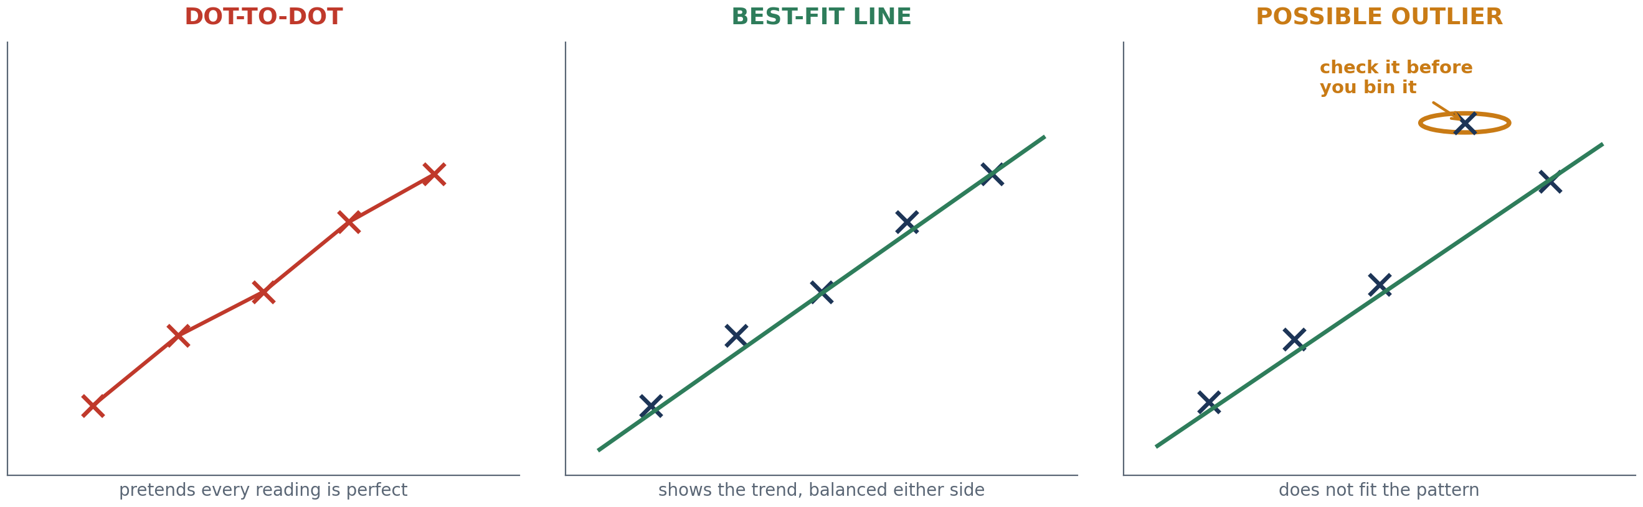
1
STARTER · BOOKLET L5 TASK 1
Which graph is better?
Which shows the pattern most clearly?
What is a dot-to-dot line claiming? Why is that untrue?
Lesson 5 · Starter
Notes:
5 MINUTES. Show all three panels, take answers, do not rush to the label. WHAT A DOT-TO-DOT LINE IS CLAIMING — this is the whole point, and it is worth getting a student to articulate it: A dot-to-dot line says "between these two measurements, the real behaviour went exactly like this, and every one of my readings is perfectly correct." Both halves of that are false. Their readings have uncertainty — they proved it themselves in Lesson 1 — so a line that bends to honour every point is bending to honour their errors. THE BEST-FIT LINE says something more modest and more honest: "the underlying pattern looks like this; my individual readings scatter around it." DRAW THE CONTRAST OUT LOUD: the zig-zag line takes the data more seriously than the data deserves. QUESTION THAT USUALLY COMES UP: "does the line have to go through the origin?" Not automatically. Only if a zero cause genuinely gives a zero effect AND the data supports it. For the ramp, zero height should give roughly zero distance, so through or near the origin is defensible — but they must decide from the points, not from habit.

Slide 39
KEY IDEA
A best-fit line shows the trend, not every measurement
DO
DO NOT
AND REMEMBER
One smooth line — straight or gently curved
Roughly as many points above as below
Ruler if it is straight, freehand and smooth if it curves
Pencil, so you can adjust it
Zig-zag from point to point
Force it through the first and last points
Assume it must pass through the origin
Draw a thick, wobbly, double-stroke line
It does not have to touch a single point.
That is not a failure — it is the line admitting that your measurements have uncertainty in them.
Which you already proved in Lesson 1.
Balanced points either side · one smooth line · never dot-to-dot
Lesson 5 · Best-fit lines
Notes:
7 MINUTES. Demonstrate on the board with the class's own ramp data — get five means from one group and plot them large. DRAW IT BADLY FIRST, ON PURPOSE. Draw a line hugging the top points. Ask "is that balanced?" Then adjust it until roughly half the points sit either side. Doing it wrong first and correcting in front of them teaches the judgement far better than drawing it correctly straight away. THE PHRASE TO REPEAT: "the line shows the trend, not the readings." STRAIGHT OR CURVED? Answer honestly: look at the points and decide. If they curve consistently, draw a curve. Do not force a straight line through obviously curved data. Most ramp data over 5-25 cm looks close to straight. CONNECT TO LESSON 1 EXPLICITLY. Task (a) asks what a best-fit line is admitting about experimental data. The answer: that every point carries uncertainty, so no line should be forced to honour each one exactly. If a student makes that link themselves, stop and make the class listen to it. PENCIL, NOT PEN. They will want to adjust it, and they should.

Slide 40
3
BOOKLET L5 TASK 3
Spot the outlier
Another class ran the ramp experiment. Plot these five points, draw the trend, then decide what to do.
Ramp height / cm | 5 | 10 | 15 | 20 | 25
Mean distance / cm | 20 | 37 | 52 | 96 | 80
a
b
c
Which value looks wrong — and what exactly makes it look wrong?
Should they delete it? What should they do FIRST?
Two things that could have caused a reading like this.
Lesson 5 · Outliers
Notes:
10 MINUTES. Plotting takes 4, the discussion takes 6, and the discussion is the valuable part. THE ANSWER (a) The 20 cm value, 96 cm. It breaks the pattern twice over: the jump from 15 to 20 cm is 44 cm when every other step is about 16, AND the 25 cm value is LOWER than it, which makes no physical sense — a higher ramp should not give a shorter distance. Push them past "it looks weird" to that second observation. It is the stronger argument and it is the kind of reasoning that earns marks. (b) NOT delete. First: check the recording — is it a copying slip, 96 for 69? Check the method — was that run different? Repeat the measurement if the equipment is still available. Only if it cannot be explained or repeated does it get reported as an outlier, circled on the graph with a note. Never silently removed. The digit-swap possibility is worth raising: 96 and 69 are one transposition apart, and 69 would sit perfectly on the trend. Real data errors often look exactly like this. (c) Causes: trolley pushed instead of released; measured to the wrong point; trolley veered and travelled further; a different start point on the ramp; number written down wrong; ramp knocked to a steeper angle. CLOSE WITH THE LINE FROM THE BOOKLET: an outlier you cannot explain gets REPORTED, not hidden. Deleting inconvenient data is the one thing a scientist must never do.

Slide 41
4
BOOKLET L5 TASK 4
Finish your own graph
Add the best-fit line to your ramp graph. Circle anything that sits well off it — or write “no outliers” and say so.
THE CHECKLIST
AND
WORTH SAYING
Title
x-axis labelled with unit
y-axis labelled with unit
Sensible scale using most of the grid
Points plotted accurately as small crosses
Best-fit line, not dot-to-dot
Outliers circled and commented on — or their absence stated
“No outliers — all points lie close to the line” is a real answer and earns the mark.
Saying nothing earns nothing.
Lesson 5 · Finish the graph
Notes:
10 MINUTES. Heads-down drawing time. Circulate and pick out two or three good examples to hold up at the end. WHAT TO WATCH FOR • Dot-to-dot lines appearing despite everything. Catch them immediately. • Lines drawn through the origin without thought. Ask whether their points support it. • Students who circle a point that is only slightly off. Not every scattered point is an outlier — ordinary scatter is expected. An outlier breaks the pattern clearly. • Students with genuinely clean data who then invent an outlier because they think they need one. Tell them to write "no outliers" and move on. THE ABSENCE STATEMENT IS A MARK. Repeat it — students lose marks for silence on outliers far more often than for misidentifying one. IF THEIR DATA IS A MESS: some groups will have points that scatter badly. That is a real result. The best-fit line still goes through the trend, and their evaluation later gets to say the data was not precise, with a named reason. Do not let them redraw fictional points. FOR FAST FINISHERS: Task 7 in the booklet — a marked-up graph with four deliberate faults to find and redraw. Point them at it rather than letting them sit.

Slide 42
5
BOOKLET L5 TASK 5
Peer review — find the fault they cannot see
Swap booklets. Mark their graph against the checklist. Then write ONE specific improvement — not “make it neater”.
THE RULE
NOT THIS
Specific or it does not count.
“Add the unit to the y-axis.”
“Your scale only uses half the grid.”
“Two points are plotted a square out.”
“Make it neater.”
“It's good.”
“Nothing to improve.”
These tell the other person nothing at all.
You will always find faults in someone else's graph that you are blind to in your own
Lesson 5 · Peer review
Notes:
5 MINUTES. Strict timing or it becomes a chat. STRUCTURE IT: 2 minutes checking against the list, 1 minute writing the improvement, 2 minutes reading and responding to what they received. WHY THIS WORKS: students genuinely cannot see faults in their own graph after twenty minutes of staring at it. They spot the same fault in someone else's in five seconds. Say that out loud — it is a real thing about attention, and it is exactly why scientists have their work peer reviewed before publication. MAKE THE LINK TO THE LESSON 7-8 HOOK: the LIGO team spent months attacking their own result before announcing it, and real papers go to reviewers whose job is to find the weakness. This is a miniature version of the same process. INSIST ON THE SPECIFIC IMPROVEMENT. If you read "make it neater" in a booklet, hand it back. BOOKLET BOXES: reviewer name, strongest thing about the graph, one specific improvement. All three get filled in.

Slide 43
6
BOOKLET L5 TASK 6
Write the conclusion
The difference between a conclusion and an opinion is a number.
THE STRUCTURE
WEAK vs STRONG
As the ramp height increased, the distance travelled …
I know this because the graph shows …
For example, at ___ cm the mean was ___ cm, while at ___ cm it was ___ cm.
One possible source of random error was …
One result that may be an outlier is ___ because …
“It went up.”
“As ramp height increased, the distance travelled increased.”
“The graph shows a pattern.”
“At 5 cm the mean was 19 cm; at 25 cm it was 82 cm.”
Lesson 5 · Conclusion
Notes:
8 MINUTES. The sentence starters are in the booklet; they write straight into it. THE ONE INSTRUCTION THAT MATTERS: every conclusion must contain at least two numbers from their own results. Without numbers it is an opinion. MODEL ONE ON THE BOARD FIRST, out loud, using a real group's data. Thirty seconds of modelling saves five minutes of blank pages. WHY THE FULL SENTENCE MATTERS: "it went up" does not say what went up or what caused it. In an exam it earns nothing. "As ramp height increased, the distance travelled increased" names both variables and the direction. That is the sentence pattern for every conclusion they will ever write in science. CIRCULATE AND ASK ONE QUESTION: "which two numbers did you quote?" If they cannot point to them, the conclusion is not finished. STRETCH FOR THOSE WHO FINISH: was the relationship linear? Could they predict the distance for a 30 cm ramp — and how confident would they be extending the line beyond the data they actually collected? That last point is genuinely subtle and worth a conversation with your strongest students.

Slide 44
CHECKPOINT
Checkpoint — Lesson 5
1
A best-fit line is ____________.
2
We avoid dot-to-dot lines because ____________.
3
An outlier is ____________.
4
Before ignoring an outlier you should ____________.
5
Why is deleting an inconvenient result dishonest, not just untidy?
Lesson 5 · Checkpoint
Notes:
2 MINUTES. ANSWERS 1. a line showing the overall trend, with points balanced either side; it need not pass through any of them 2. they treat every reading as perfect, when every measurement carries uncertainty 3. a result that does not fit the pattern of the others 4. check the recording and the method, and repeat the measurement if you can 5. Because it changes what the evidence says. Untidy work is hard to read; deleted data is a different claim about reality. Once you remove results because you did not like them, nobody can trust anything else you report — and, as the ozone story shows, the result you throw away may be the discovery. TAKE 5 OUT LOUD. It is the moral centre of the unit and it deserves thirty seconds of class attention. NEXT LESSON: they do the whole thing alone — variables, table, repeats, means, graph, best-fit line, conclusion. Tell them now so they arrive expecting it. HOMEWORK (booklet): find a graph outside school and run it through the checklist on page 3.

Slide 45
LESSON
6
Solo flight
Paper helicopter challenge · the whole process, on your own
THE SHAPE OF THE LESSON
1
2
3
4
5
6
The case
Plan it
Design your table
Fly and record
Graph and conclude
Self-assess
Lesson 6
Notes:
LESSON 6 — light-touch assessment of the whole unit. The instruction to yourself is: DO NOT HELP TOO MUCH. WHAT THIS LESSON IS FOR You find out which students can run the process without scaffolding. That information is what makes Lessons 7-8 groupings sensible. HOW TO PITCH IT: "Everything you need is already in your booklet. I will answer questions about safety and equipment. I will not tell you what your variables are." DIFFERENTIATION • Support: the booklet has a printed example table in Lesson 6's notes area; point them at the Lesson 4 table as a model. Some students may need the wing lengths given to them. • Stretch: let them choose paperclip mass or drop height as the independent variable instead, or ask for a prediction read off the best-fit line. EQUIPMENT PER STUDENT: paper (identical weight for everyone), scissors, 2-3 paperclips, stopwatch, metre ruler. Pre-cut templates save five minutes and remove a variable. TEMPLATE: a rectangle roughly 20 cm × 10 cm, cut down the middle from the top to make two wings, folded in opposite directions, with the bottom folded up and a paperclip added. TIMING RISK: helicopter construction expands to fill any time given. Fifteen minutes for building AND flying is the discipline.

Slide 46
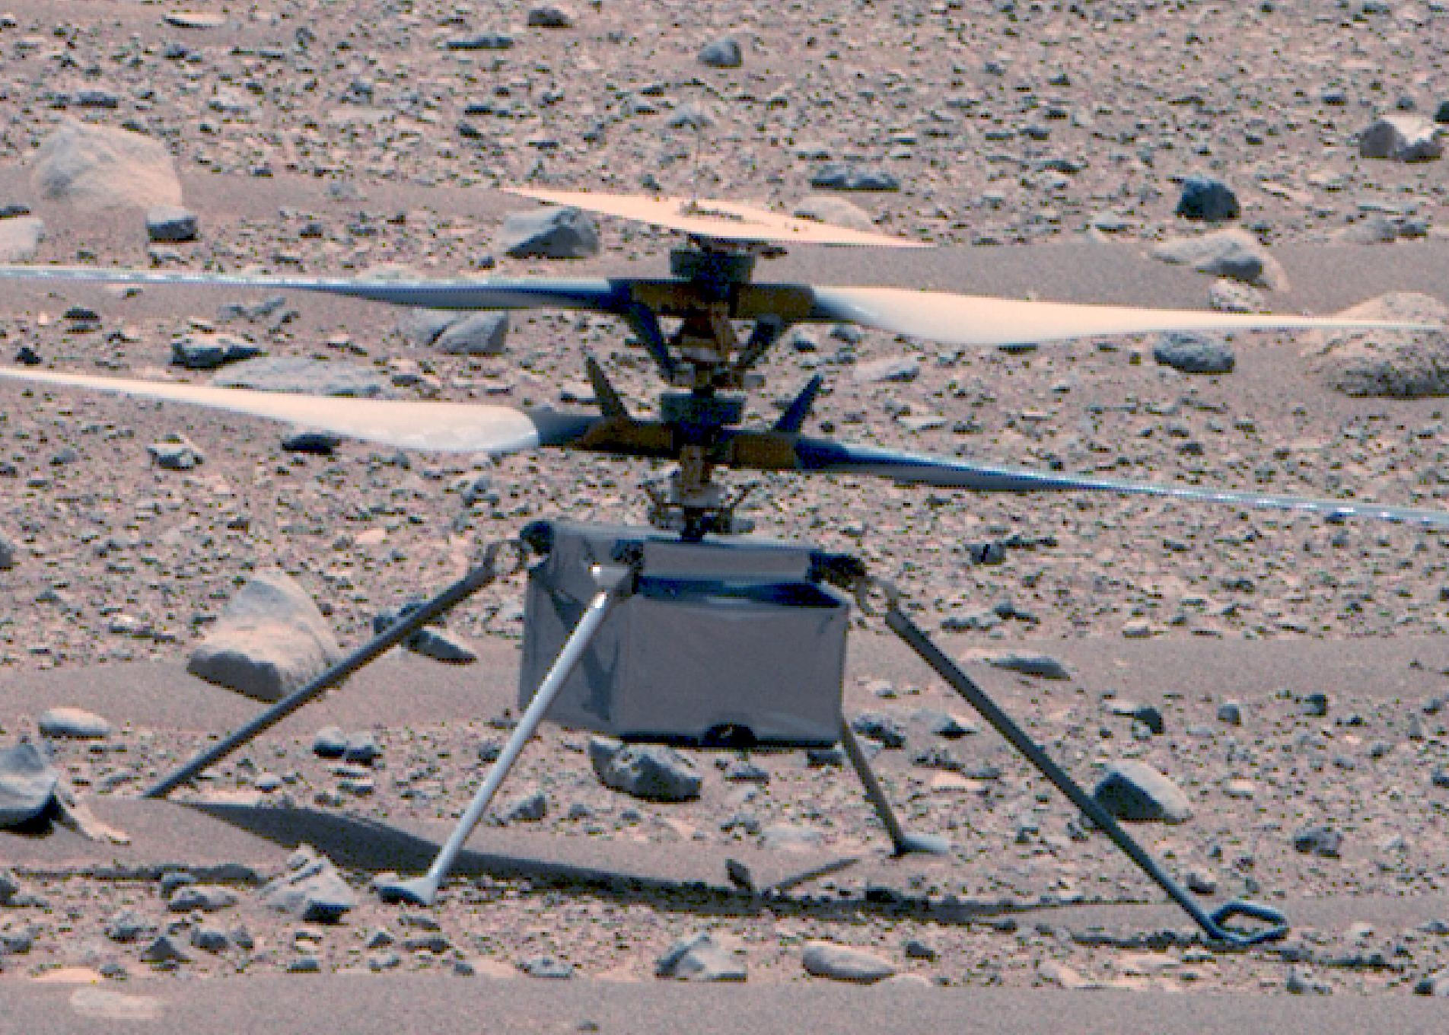
THE CASE
The helicopter that flew on Mars
In April 2021 a small helicopter called Ingenuity lifted off the surface of Mars. Getting it to fly was brutally hard: the Martian atmosphere is around one per cent as dense as Earth's, so the rotors have almost nothing to push against.
The engineers could not just try it and see. They tested rotor designs in a chamber pumped down to Martian pressure, changing blade size and spin rate, measuring lift, and reading the pattern off the graph.
Ingenuity's rotors ended up about 1.2 m across, on a craft weighing under 2 kg.
Photo: NASA/JPL-Caltech/ASU/MSSS
Same process, smaller stakes. This one is on you.
Lesson 6 · The case
Notes:
2-3 MINUTES, then hands off. THE POINT OF THE STORY: the engineers could not test on Mars, so the graph had to do the predicting. Exactly what the students will do — measure five wing lengths, then read a prediction off the line for a length they never tested. THE DETAIL WORTH KEEPING: rotors over a metre wide on a craft lighter than a bag of sugar. That ratio is what "thin atmosphere" means in practice, and it is memorable. THE DIAGRAM ON SCREEN doubles as the practical brief. Point at it: wing length is what you change, fall time is what you measure, everything else stays the same. THEN SAY THE HARD PART OUT LOUD: "From here, I am not telling you what your variables are. Everything you need is in your booklet." Resist the urge to fill silence. The point of this lesson is finding out what they can do unaided.
[Sources] Case photo: Ingenuity at Two Years on Mars (PIA25881). Credit: NASA/JPL-Caltech/ASU/MSSS. https://commons.wikimedia.org/wiki/File:Ingenuity_at_Two_Years_on_Mars_(PIA25881).jpg Case background: https://www.jpl.nasa.gov/news/nasas-ingenuity-mars-helicopter-succeeds-in-historic-first-flight/ [/Sources]

Slide 47
1
BOOKLET L6 TASK 1
Plan before you cut anything
Recommended question: how does wing length affect the fall time of a paper helicopter?
FILL IN YOURSELF
AND DECIDE
SAFETY
Research question
Independent variable + unit
Dependent variable + unit
Three control variables
Continuous or categoric?
Which graph — and why?
The five values you will test
No climbing on chairs, stools or benches.
Use a drop height you can reach standing on the floor — and use the same one every time.
Care with scissors. Landing zone clear.
Lesson 6 · Plan
Notes:
7 MINUTES. Let them struggle a little. Circulate but answer questions with questions. THE ANSWERS THEY SHOULD REACH THEMSELVES Independent — wing length in cm — continuous Dependent — fall time in s Control — same paper, same number of paperclips, same drop height, same person timing Graph — line graph, because wing length is continuous Values — 4, 5, 6, 7, 8 cm works well WHEN THEY ASK "IS THIS RIGHT?", reply: "What kind of variable is wing length? So which graph does that give you?" Make them run the rule. SAFETY IS THE ONE THING YOU DO ENFORCE HARD. Every year someone stands on a stool for extra height. Set the drop height as a class — arm's reach above head height, from the floor, marked on the wall — and hold everyone to it. THE CONTROL VARIABLE THEY FORGET is "same person timing". Swapping timers mid-experiment introduces a new systematic difference. If nobody in the room has written it, raise it with the whole class — it is a genuinely useful point and it will show up in their evaluations. DROP HEIGHT AS A CONTROL: if they choose drop height as their independent variable instead, then wing length becomes a control. Some students find that swap illuminating.

Slide 48
2
ASSESSED · BOOKLET L6 TASK 2
Design your own results table
Nothing is printed for you. Draw it yourself in the space provided.
A GOOD TABLE HAS
A WEAK TABLE
A column for the independent variable
Three trial columns
A mean column
Units in EVERY heading
Units written next to every number instead of in the heading
No mean column
Only one trial
Headings that do not say what was measured
This is assessed. The table is the first thing a marker looks at.
Lesson 6 · Table
Notes:
5 MINUTES. Do not draw it for them. This is the single clearest indicator of who has internalised the unit. WHAT YOU ARE LOOKING FOR AS YOU WALK AROUND • Units in the headings, not beside every number. This is the most common fault and the easiest mark to lose. • A mean column that exists BEFORE they collect data, not added afterwards. • Five rows for five wing lengths. • Sensible heading wording: "Wing length / cm", "Time trial 1 / s", "Mean time / s". DIFFERENTIATION: if a student is genuinely stuck after two minutes, tell them to look back at their Lesson 4 table and copy its STRUCTURE with new headings. That is a legitimate strategy, not cheating — recognising that the structure transfers is itself the skill. DO NOT let anyone start cutting paper until their table exists. Students who build first and design the table afterwards end up recording results on the back of their hand. QUICK WIN: ask two students to hold up their tables at 14 minutes and have the class spot the difference. Ten seconds, and it fixes several tables at once.

Slide 49
3
PRACTICAL · BOOKLET L6 TASK 3
Fly and record
Build, drop, time, repeat. Three trials before you change anything.
GETTING DECENT TIMINGS
IF A DROP GOES WRONG
The same person times every drop
Start the watch as the helicopter is released
Fall times are short, so reaction time matters — which is exactly why you repeat
Hits a desk, catches a draught, someone knocks your arm — say so and take it again.
Note it down.
A discarded trial with a written reason is honest. A quietly deleted one is not.
Build fast — the graph and the conclusion are the parts that get marked
Lesson 6 · Practical
Notes:
18 MINUTES, and it will feel like ten. Call the phase changes. THE BUILD IS THE TIME TRAP. Five minutes, no more. Pre-cut templates if you can — it removes both the time and a source of variation. CONSISTENCY IN THE BUILD MATTERS: same paper, same fold, same paperclips. Only the wing length changes. Students will unconsciously make the long-winged one more carefully. WHAT TO CHASE • Timing from the wrong moment. Watch starts when the helicopter leaves the hand. • Different people timing different lengths. • Drop height creeping up as they get bolder. Watch for anyone on tiptoes. • Students recording two trials and calling it three. THE HONESTY POINT — Task 3(a) — is worth stopping the room for if a good example arises: a discarded trial WITH A WRITTEN REASON is good practice. Silently binning one is not. This is the Lesson 5 outlier lesson showing up in their own hands, and it is much more powerful here. AT 33 MINUTES: helicopters down, means calculated, graph next. Be firm — the graph and conclusion are the assessed parts.

Slide 50
4
ASSESSED · BOOKLET L6 TASKS 4–5
Graph it, conclude it, predict something
Everything from the unit in one graph. Then read a prediction off your own best-fit line.
THE GRAPH
THE CONCLUSION
THE PREDICTION
Title · axes · units · sensible scale
Points as small crosses
Best-fit line
Outliers circled — or their absence stated
As wing length increased, the fall time …
Quote two numbers from your own results
Say whether there is a possible outlier
Using the line only, what fall time would a wing length you did NOT test give?
State the value and where you read it from.
Lesson 6 · Graph and conclude
Notes:
12 MINUTES. The assessed heart of the lesson. EXPECTED RESULT: longer wings generally give longer fall times — more air resistance, slower descent. But paper helicopter data is genuinely noisy, and some classes get a flat or messy relationship. That is fine and it is honest. Do not steer them towards a "correct" answer. IF A STUDENT'S DATA SHOWS NO PATTERN: that is a real finding. Their conclusion should say the results do not show a clear relationship, and their evaluation should say why — timing uncertainty of ±0.2 s against fall times of about 2 s is a large fraction. That is a sophisticated answer and worth more than a tidy fake trend. THE PREDICTION TASK is the pay-off from Lesson 4's hook. Make sure everyone attempts it. They pick a wing length between two they tested, go up to the line, across to the axis, and read the value. Emphasise: this is a number they never measured, and the graph gave it to them. STRETCH: ask whether they would trust the same line for a 20 cm wing. No — that is far outside the data they collected, and there is no reason the pattern continues. Extrapolation deserves suspicion. MARKING: the booklet's success-criteria checklist in Task 6 is written in the same words you should mark against.

Slide 51
SELF-ASSESSMENT · BOOKLET L6 TASK 6
Mark yourself — then Checkpoint
1
Variables · table with units · three trials · means calculated
2
Correct graph type, with a reason given
3
Axes, units, sensible scale · best-fit line, not dot-to-dot
4
Outliers identified or their absence stated · conclusion quotes evidence
5
Then: the most important thing I have learned about collecting data …
6
… and one thing I would do differently next time, with the reason.
Lesson 6 · Self-assessment
Notes:
5 MINUTES. Self-assessment first, then the two reflection questions. BE STRICT ABOUT STRICTNESS. Tell them: if you tick everything, I will check. Students who over-rate themselves are usually the ones who have missed the units. THE CONVERSATION WORTH HAVING: pick two or three students and ask "which one did you not tick, and why?" The ability to identify your own gap is more valuable than the mark. WHAT TO DO WITH WHAT YOU LEARN: this lesson tells you who can run the process alone. Use it to build the Lesson 7-8 groups — pair a confident planner with someone who needs support, and avoid grouping three students who all struggled with the table. COLLECT THE BOOKLETS if you want to mark Lesson 6 formally. It is the natural assessment point in the unit. HOMEWORK (booklet): four evaluation sentences — one strength, one weakness, one random error, one improvement. They will need all four in Lessons 7-8, so it is worth setting properly.

Slide 52
LESSON
7
Your investigation — planning
Lessons 7–8 project · design it, get it approved, run it
THE SHAPE OF THE LESSON
1
2
3
4
5
6
7
The case
The rules
Choose a question
Planning grid
Teacher sign-off
Collect data
Checkpoint
Lesson 7
Notes:
LESSON 7 — planning and data collection. Lesson 8 is analysis and presentation. GROUPS: pairs or threes. Threes work where equipment is short or where a timer, a dropper and a recorder are all needed. Use what you learned in Lesson 6 to build them. THE NON-NEGOTIABLE: nobody collects data until you have signed their plan. This is both a safety requirement and the single best use of your time this lesson — five minutes of checking prevents a wasted lesson. EQUIPMENT: put out a mixed pool from the whole unit — ramps, trolleys, balls, materials, paper, paperclips, elastic bands, springs, masses, rulers, stopwatches. Groups choose from what is visible. Tell them at the start that they can only use what is on the table. PREPARE FOR: two or three groups wanting to do something you have not anticipated. Judge on safety and measurability. If it is safe and it produces numbers, let them. TIMING RISK: the planning phase over-runs and data collection gets squeezed. Hold the 25-minute line hard.

Slide 53
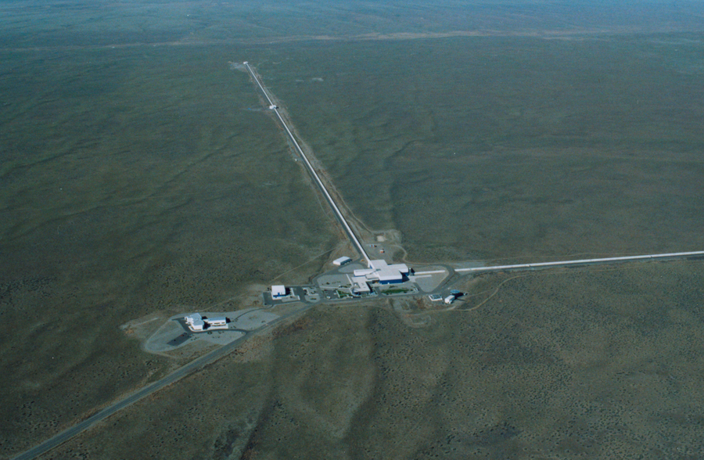
THE CASE
The scientists who tried to prove themselves wrong
In 2015 the LIGO detectors picked up a signal from two black holes colliding a billion light years away. It was the first direct detection of gravitational waves, and it won a Nobel Prize.
They did not announce it. For months they attacked their own result — checking instruments, ruling out interference, running the analysis again. The collaboration had even used blind injections before: secret fake signals slipped into the data to test whether the team would spot them and follow their own procedures.
Only once they had failed to break their own result did they publish.
Photo: Caltech/MIT/LIGO Lab
Your job over these two lessons: produce a result you cannot break.
Lesson 7 · The case
Notes:
3 MINUTES. This story sets the standard for the project. THE IDEA TO LAND: the default instinct is to defend your result. A scientist's job is to attack it first, because if you do not, someone else will — and it is far better to find the flaw yourself. BLIND INJECTIONS ARE WORTH EXPLAINING: the collaboration deliberately planted fake signals in their own data, known to only a handful of people, to check that the team would catch them and follow procedure properly. They built a test of their own honesty into the experiment. THE QUESTION FOR THE CLASS: "What would it mean to try to break your own result in this project?" Answers you want: repeat the measurement you are least sure about; check whether a control variable really stayed the same; ask another group to look at your graph; ask whether anything other than your independent variable could explain the pattern. THEN SET THE TASK: two lessons, one question, evidence you can defend. Move on — planning needs the time.
[Sources] Case photo: LIGO Hanford aerial view. Credit: Caltech/MIT/LIGO Lab. https://www.ligo.caltech.edu/image/ligo20150731e Case background: https://www.ligo.caltech.edu/detection [/Sources]

Slide 54
1
BOOKLET L7 TASK 1
The rules
EVERY GROUP MUST
AND EVERY GROUP MUST
Work in a pair or a three
Ask one question: “How does X affect Y?”
Change ONE independent variable
Measure ONE dependent variable
Identify at least three control variables
Test at least four or five values or categories
Take at least three trials of each
Calculate a mean for each
Choose the correct graph type
Write a conclusion AND an evaluation
Nobody touches equipment until your plan is signed
Lesson 7 · Rules
Notes:
5 MINUTES. Read the rules once, clearly, and leave them on screen while groups form. THE TWO RULES THAT GET BROKEN 1. ONE independent variable. Groups want to change two things "to save time". Explain again that it makes the result uninterpretable — the energy drink study from Lesson 2 is the reference point. 2. Four or five values, three trials each. That is 12-15 measurements. Groups planning nine measurements have not read the rules. DO THE ARITHMETIC WITH THEM: 5 values × 3 trials = 15 runs in 20 minutes = 80 seconds per run including setup. That number tells them immediately whether their idea is feasible. A group planning to heat water to five temperatures will not manage it; a group rolling a trolley will. FEASIBILITY IS THE MOST USEFUL THING YOU CAN TEACH IN THIS LESSON. Ask every group: "how long does one measurement take you?" and let them do the multiplication. GROUPS OF THREE need three jobs. Assign them explicitly — one operates, one measures, one records — or the third student watches.

Slide 55
2
BOOKLET L7 TASK 2
Choose a question that will actually work
THESE WORK
THESE DO NOT
How does ramp height affect distance travelled? — LINE
How does wing length affect fall time? — LINE
How does surface type affect distance? — BAR
How does material affect bounce height? — BAR
How does the number of elastic bands affect launch distance? — LINE
“What is the best paper helicopter?” — too vague
“How does height affect it?” — dependent variable unclear
“How does surface affect speed and distance and time?” — too many dependent variables
“How does throwing force affect distance?” — cannot be controlled fairly
Write it as “How does X affect Y?” — if you cannot, the question is not ready
Lesson 7 · Question
Notes:
7 MINUTES. Let them choose, then challenge each choice. THE REJECTED QUESTIONS ARE THE TEACHING. Work through why each fails — booklet Task 2 asks them to write the reason: • "Best paper helicopter" — best at what? Nothing is being measured. • "How does height affect it?" — what is "it"? No dependent variable. • "Speed and distance and time" — three dependent variables means three investigations and no time for any of them. • "Throwing force" — you cannot repeat a throw with the same force, so it is not controllable. This one is subtle and worth discussing; students think of it as a number when it is not measurable with what is in the room. THE TEST TO GIVE THEM: can you write it as "How does X affect Y?" with one thing in each slot, and can you say what unit Y is measured in? If not, it is not ready. ENCOURAGE A SPREAD ACROSS THE CLASS. If every group does ramp height, Lesson 8's comparison work is dull. Push two or three groups towards categoric questions so the room produces both bar charts and line graphs — that contrast is the best plenary available in Lesson 8.

Slide 56
3
BOOKLET L7 TASKS 3–5
Plan, write the method, get it signed
Planning grid → method → teacher checkpoint. No signature, no equipment.
THE PLANNING GRID
THE METHOD
THE SIGN-OFF
Question · variables · units
Continuous or categoric?
Which graph, and why
Three control variables
Equipment · risks · how you reduce them
Numbered steps.
Someone from another class should be able to follow it without asking you anything.
Include how many trials and how you keep the controls the same.
Question testable · variables clear · controls realistic · method safe · equipment available · repeats included · units in the table · graph choice sensible
Lesson 7 · Planning and sign-off
Notes:
10 MINUTES TOTAL — about 7 planning, 3 signing. Start signing the moment the first group is ready; do not wait for everyone. BE FAST AND FIRM AT THE CHECKPOINT. Thirty seconds per group. Run the eight checks on the card. If something is missing, hand it back and move on — they fix it and rejoin the queue. THE THREE THINGS THAT USUALLY FAIL 1. Control variables that are not real. "Keep it fair" is not a control variable. 2. No repeats in the plan. 3. A method that skips the measurement step — they describe what they will do but not what they will measure or from where. SAFETY JUDGEMENTS YOU MAY NEED • No dropping from windows, chairs, stools or benches. • Nothing launched towards people. • Heavy masses handled at bench height, feet clear. • Anything involving heat, chemicals, electricity or sharp objects needs your explicit approval. SIGN AND DATE THE BOOKLET BOX. Students take it seriously when the signature is real, and it gives you a record of who was ready. WHILE YOU SIGN, groups that are waiting should be drawing their results table.

Slide 57
4
BOOKLET L7 TASK 6
Collect your data
Four or five values · three trials each · units in the headings · record as you go.
WHILE YOU COLLECT
LAB NOTES · Task 6b
Record results the moment you take them
Units in the headings, not next to every number
If a result looks odd, check it NOW — you will not get the equipment back
Equipment that misbehaved. A trial you repeated. A control variable that slipped. Anything surprising.
This is where your evaluation comes from next lesson. You will not remember.
Circulate: “how many trials so far?” · “show me your units” · “anything you don't believe?”
Lesson 7 · Data collection
Notes:
20 MINUTES. Your job is triage, not teaching. THE LAB NOTES BOX IS THE MOST VALUABLE THING ON THIS SLIDE and the easiest to skip. Groups that write nothing here produce vague evaluations next lesson ("we could have been more accurate"). Groups that write "the ramp slipped on run 3 so we redid it" produce specific ones. Point at least three groups towards it explicitly. PRIORITISE YOUR CIRCULATION 1. Groups with no data after five minutes — something is wrong with their method; intervene. 2. Groups with no units in their headings — fix immediately. 3. Groups taking one trial per value — send them back. 4. Groups who have finished early — send them back for a fourth trial or a sixth value, not to chat. DO NOT FIX THEIR EXPERIMENT FOR THEM. If a method is flawed but safe, let it run. A flawed method that produces a discussable evaluation is worth more than a perfect one you handed them. WATCH THE CLOCK AT 40 MINUTES: call five-minute and two-minute warnings. Everything away by 45. IF A GROUP FINISHES A COMPLETE DATA SET EARLY, get them to start calculating means. It buys time in Lesson 8.

Slide 58
CHECKPOINT
Checkpoint — end of Lesson 7
1
Our research question is ____________.
2
Our independent variable is ________ and it is ________.
3
Our dependent variable is ____________.
4
One control variable we genuinely managed to keep the same was ____________.
5
One result we may need to check next lesson is ____________.
Lesson 7 · Checkpoint
Notes:
5 MINUTES. Written in the booklet, then two or three read out. WHY QUESTION 4 SAYS "GENUINELY": it invites honesty. Most groups will find one control variable they did not really manage. Naming it now makes the evaluation in Lesson 8 much easier to write, and it rewards honesty rather than tidiness. QUESTION 5 sets up Lesson 8's outlier work with their own data. If a group says "none", ask whether they checked — or just did not look. BEFORE THEY LEAVE, make sure every group has: a complete data table, units in the headings, and something written in the lab notes box. Any group missing data will struggle next lesson, so note who they are now and decide whether they need ten minutes of equipment at the start of Lesson 8. NEXT LESSON: means, graph, conclusion, evaluation, peer review. Tell them there is no equipment and no more data collection — that is deliberate, and it is how real projects work.

Slide 59
LESSON
8
Your investigation — analysis
Means · graph · conclusion · evaluation · peer review
THE SHAPE OF THE LESSON
1
2
3
4
5
6
Decide the graph
Draw it
Interrogate the results
Conclusion + evaluation
Peer review
Final checkpoint
Lesson 8
Notes:
LESSON 8 — the payoff lesson. No equipment, no data collection. Say that at the door. WHAT THEY MUST PRODUCE Means · the correct graph, well drawn · a conclusion quoting evidence · an evaluation naming real errors and one improvement. THIS IS WHERE THE UNIT IS ASSESSED. The success criteria in the booklet are written in the words you should mark against, and students have already self-assessed against the same list in Lesson 6. THE BEST PLENARY AVAILABLE: if some groups did categoric investigations and some continuous, put one bar chart and one line graph side by side at the end and ask the class why they are different. It closes the unit on the idea it opened with — the graph follows the independent variable. FOR ANY GROUP WITH INCOMPLETE DATA: give them the class ramp data or a partner group's results rather than losing the whole analysis lesson. Analysing someone else's data is a legitimate exercise.

Slide 60
7
BOOKLET L8 TASK 7
Decide your graph first
Five questions. Answer all five, then work out your scale. Only then pick up a pencil.
THE FIVE
THEN THE SCALE
Is your independent variable continuous or categoric?
So: line graph or bar chart?
What goes on the x-axis?
What goes on the y-axis?
What units are needed, and where?
Largest mean value = ?
Big squares available = ?
Divide, then round UP to 1, 2, 5, 10, 20 or 50 per square
Check the largest value still fits
Continuous → line graph. Categoric → bar chart. It depends on what you CHANGED.
Lesson 8 · Decide
Notes:
8 MINUTES, including calculating any means still outstanding. START WITH MEANS. Any group who has not finished them does that first — the graph cannot start without them. Insist on one worked mean calculation written out in the booklet. THEN THE FIVE QUESTIONS. They are in the booklet as a table; students fill it in before drawing. Check the answers as you circulate — it takes ten seconds per group and catches a wrong graph type before it costs twenty minutes. THE SCALE STEP IS NOT OPTIONAL. Same routine as Lesson 4. Make them write down what one big square is worth before they draw an axis. COMMON PROBLEM: a group whose independent variable is "number of paperclips" or "number of elastic bands" and who cannot decide if it is continuous. Accept either with a reason at this level; a line graph is the more useful choice because it shows a trend, and that is a defensible argument. What matters is that they can justify the decision. SECOND COMMON PROBLEM: bar chart groups who want to sort their bars by height. Sorting is fine and often clearer — but the categories must keep their labels and the gaps stay.

Slide 61
8
ASSESSED · BOOKLET L8 TASK 8
Draw it properly
Everything from the unit, in one graph. This is the assessed piece.
CHECK BEFORE YOU HAND IT IN
Right graph type for your variable
Independent variable on the x-axis
Units on BOTH axes
Scale readable and filling the grid
Points accurate — check two against your table
Best-fit line, not dot-to-dot
Bars equal width with gaps
Outliers circled — or “no outliers” written
Lesson 8 · Draw
Notes:
17 MINUTES of drawing. The longest uninterrupted work period in the unit — protect it. CIRCULATE CONSTANTLY. Every fault caught in the first five minutes saves a redraw. THE ORDER TO CHECK, per group 1. Right graph type for their variable. 2. Independent variable on the x-axis. 3. Units on both axes. 4. Scale readable and filling the grid. 5. Points accurate — spot-check two against their table. 6. Best-fit line, not dot-to-dot (line graphs only). 7. Outliers circled with a note, or a written statement that there are none. BAR CHART GROUPS: equal widths, equal gaps, bars showing means. They do not draw a best-fit line — make sure nobody does out of habit. LINE GRAPH GROUPS: the best-fit line is the thing they will get wrong. Watch for zig-zags reappearing under time pressure. IF SOMEONE FINISHES AT 18 MINUTES: send them to Task 13 (compare with another group, linear or non-linear, what range would you test next). Do not let them sit. CALL A WARNING AT 22 MINUTES. Nobody should still be drawing axes at 25.

Slide 62
9
BOOKLET L8 TASK 9
Interrogate your own results
THE PATTERN
THE DOUBTS
THE HARD ONE
What does the graph show — increase, decrease, or no clear change?
Is it strong and clear, or weak and scattered? What in the graph tells you that?
Any possible outliers? Say which — or state clearly that there are none.
What is the single strongest piece of evidence in your results?
Which number would a doubter find hardest to argue with?
And which part of your method would they attack first?
Lesson 8 · Analyse
Notes:
8 MINUTES. This is the LIGO hook made practical — they attack their own result before anyone else does. "STRONG OR WEAK" is the question students find hardest. Give them the criteria: Strong — points sit close to the line, the trend is clear, repeats at each value agree with each other. Weak — points scatter widely, repeats at the same value disagree, the trend could plausibly be a flat line. A WEAK RESULT IS NOT A FAILED PROJECT. Say so plainly. A group who reports "our results do not show a clear relationship, because the spread within our repeats is as large as the difference between our values" has done better science than a group who drew a confident line through noise. Reward it. THE DOUBTER QUESTION is the most valuable one on the slide. Ask each group directly as you circulate: "if I wanted to say your conclusion was wrong, where would I attack?" The answers become their evaluation, almost word for word. TYPICAL GOOD ANSWERS: "we only did three trials"; "we could not really keep the release the same"; "our timing had about the same uncertainty as the difference we measured"; "we only tested five values over a small range".

Slide 63
10
ASSESSED · BOOKLET L8 TASKS 10–11
Conclusion and evaluation
CONCLUSION
EVALUATION · where the marks hide
LINE: As ___ increased, ___ increased / decreased.
BAR: The category with the highest ___ was ___.
Both: I know this because … and the numbers that prove it are …
This suggests that …
One strength of our method was …
One weakness was …
One possible RANDOM error was …
One possible SYSTEMATIC error was …
If we repeated it we would improve it by …
“Human error” is not an answer. Name the actual thing that went wrong.
Lesson 8 · Conclusion and evaluation
Notes:
9 MINUTES. Roughly 4 on the conclusion, 5 on the evaluation. CONCLUSION — the rule is unchanged from Lesson 5: at least two numbers from their own results. Without numbers it is an opinion. EVALUATION — this is where the marks are, and where students write nothing useful unless you push. The four sentences must be SPECIFIC: Weak: "we could have been more accurate." Strong: "our stopwatch timing had an uncertainty of about ±0.2 s, which is about ten per cent of a 2 s fall time, so small differences between wing lengths were hidden." Weak: "human error." Strong: "we judged the bounce height by eye, and the ball moved too fast to read the ruler reliably — a random error." Weak: "we would do more repeats." Strong: "we would film each drop and play it back frame by frame, so the fall time does not depend on reaction time." THE RANDOM vs SYSTEMATIC PAIR is directly from Lesson 1. If they can name one of each, from their own practical, with a mechanism attached, the unit has done its job. POINT THEM AT THEIR LAB NOTES from last lesson. Groups who wrote something there have their evaluation half-written already — say so, loudly, so the ones who did not learn the lesson.

Slide 64
12
BOOKLET L8 TASK 12
Peer review — find their weakness
Swap with another group. Work the checklist. Then write the one question you would ask them.
CHECK
AND CHECK
THEN WRITE
Question in “How does X affect Y?” form
All three variable types identified
Units in the table · three trials · means
Correct graph type · axes · units · scale
Points or bars accurate
Best-fit line where appropriate
Outliers considered
Conclusion uses evidence
Evaluation names a real improvement
The strongest part of this investigation.
The one question you would ask this group.
Make the question a real one — the point is to find what they missed.
Lesson 8 · Peer review
Notes:
6 MINUTES. Three minutes reviewing, three minutes reading and responding to what came back. FRAME IT WITH THE HOOK: this is what the LIGO team did to themselves for months, and what happens to every scientific paper before it is published. Reviewers are not being unkind — a reviewer who finds your flaw before publication has done you a favour. THE QUESTION THEY WRITE is the valuable part. Model two on the board: "Why did you only test four values when the range was so wide?" "How did you make sure the release was the same every time?" Ban "it's really good". If you see it, hand the booklet back. GROUPS WHO REVIEWED A DIFFERENT KIND OF INVESTIGATION get the most from this — a bar chart group reviewing a line graph group has to think about why the graphs differ. Pair them deliberately if you can. RESPONDING MATTERS: give them the full three minutes to read the review and write a one-line response. Accepting a fair criticism in writing is a skill, and it is the closest thing to scientific practice in the whole unit.

Slide 65
END OF UNIT
Checkpoint — and that is the unit
1
The most important decision in our investigation was ____________.
2
The strongest evidence from our results was ____________.
3
The biggest source of error was probably ____________.
4
What I personally contributed to the group.
5
The hardest part of the whole unit — and what I would tell next year's Year 9 about it.
Lesson 8 · End of unit
Notes:
2 MINUTES, then close the unit properly. THE CLOSING MOVE — worth the last sixty seconds: Hold up a bar chart from one group and a line graph from another. Ask the class why they are different. The answer is the sentence the whole unit was built on: it depends on what you changed, not what you measured. Then the unit's summary line, which is printed at the back of their booklet: "Measure it more than once, be honest about the doubt, show the pattern clearly, and let the evidence decide." WHAT TO COLLECT: booklets, for assessment against the Lesson 8 success criteria. Question 4 (personal contribution) is useful for moderating group marks. HOMEWORK (booklet): individual reflection — what the group investigated, what they contributed, the hardest part, and the first objection a stranger would raise to their conclusion. That last question is the best one in the booklet and often produces the most honest writing of the unit. WHERE THIS GOES NEXT: every required practical they meet from here uses this process. When they write an evaluation in Year 10, refer them back to this booklet — the structure does not change.

